Slide 1
This content is legal only for participants of ReyChem RPG Baroda Nov’17 Training
This content is legal only for participants of Toshiba Bangalore Dec’17 Training

Slide 2


Project Management Workshop
Trainer : Hari Prasad Thapliyal
(PMP, PMI-ACP, CSM, SPOC, SDC, SAM, MCT, SCT, MBA, MCA, PGDOM, PGDFM, CIC, PRINCE2-Practitioner, ZED Master Trainer)
[PMI-ACP : #318050]
[PMP : #1563385]
This content is legal only for participants of Toshiba Bangalore Dec’17 Training
Copyright: Vedavit Project Solutions
hari.prasad@vedavit-ps.com
PMP, 'PMI-ACP‘ and 'PMI‘ are a registered marks of the Project Management Institute, Inc.

Slide 3

Project Management Workshop
Trainer : Hari Prasad Thapliyal
(PMP, PMI-ACP, CSM, SPOC, SDC, SAM, MCT, SCT, MBA, MCA, PGDOM, PGDFM, CIC, PRINCE2-Practitioner, ZED Master Trainer)
[PMI-ACP : #318050]
[PMP : #1563385]
This content is legal only for participants of ReyChem RPG Baroda Nov’17 Training
The Knowledge House
Minerva, E-109, Office No. 11 & 13 1st Floor, Pandav Nagar,
Near Hero Auto Needs, NH 24, Delhi-110092(India)
Ph: 9810590602
e-mail: info@tkh.co.in
PMP, 'PMI-ACP‘ and 'PMI‘ are a registered marks of the Project Management Institute, Inc.

Slide 4

Project Management Workshop
Trainer : Hari Prasad Thapliyal
(PMP, PMI-ACP, CSM, SPOC, SDC, SAM, MCT, SCT, MBA, MCA, PGDOM, PGDFM, CIC, PRINCE2-Practitioner, ZED Master Trainer)
[PMI-ACP : #318050]
[PMP : #1563385]
Copyright: Vedavit Project Solutions
hari.prasad@vedavit-ps.com
PMP, 'PMI-ACP‘ and 'PMI‘ are a registered marks of the Project Management Institute, Inc.

Slide 5
Introduction
Name
Role
Experience (Total/PM)
Hobby
Expectations

Slide 6
Workshop Agenda
Day 1:
PMI & PMP
Project Management Framework
Day 2:
PM Framework Continue…
Project Integration Management
Day 3:
Project Scope Management
Project Schedule Management
Day 4:
Project Cost Management
Project Quality Management
Day 5:
Project Resource Management
Day 6:
Project Communication Management
Project Stakeholder Management
Day 7:
Project Risk Management
Project Procurement Management
Professional Responsibility
Day 8:
Review All
Case Study
200 Question Exam & Review
Demo Online Tutorial

Slide 7
Workshop Agenda
Day 1:
PMI & PMP
Project Management Framework
Day 2:
Project Integration Management
Project Scope Management
Project Time Management
Day 3:
Project Cost Management
Project Quality Management
Project Human Resource Management
Day 4:
Project Communication Management
Project Stakeholder Management
Project Risk Management
Project Procurement Management
Professional Responsibility

Slide 8
Workshop Agenda
Day 1:
PMI & PMP
Project Management Framework
Day 2:
Project Integration Management
Project Scope Management
Day 3:
Project Time Management
Project Cost Management
Day 4:
Project Quality Management
Project Human Resource Management
Project Communication Management
Day 5:
Project Stakeholder Management
Project Risk Management
Project Procurement Management
Professional Responsibility

Slide 9
Workshop Ground Rules
Please keep your mobile on the silent mode. Always take your calls outside the training room.
No corner talk! Discussions only when group discussion is allowed
Keep your focus on the ongoing topic. Await your turn during the questionnaire round.
Strictly follow the workshop schedule for management of time.
There is parking lot. Write you questions and post with your name on parking lot.
Breaks only on agreed time
Tea
Lunch
Tea
Everybody need to contribute
Use your experience only for relating the processes and best practices. To avoid confusion keep it outside of the class. Unlearning is first and biggest learning to learn something new.
Two Bowls
Notes:
Project Management Concepts
06/28/13
Version 3.1, 4/01 © 2003 by AstroWix
9

Slide 10
Workshop Objective
Learn Project Management best Practices as per PMBOK 6th Edition
Build confidence to handle day to day Project Management Challenges
Getting accustomed to new terminology of Project Management
Understand the PMP ® certification process
Get familiarize with number of multiple choice questions in line with the PMP ® Certification
Build confidence to face the PMP ® examination challenge
Notes:
Project Management Concepts
06/28/13
Version 3.1, 4/01 © 2003 by AstroWix
10

Slide 11
PMI® & PMP® An Overview
Notes:
Project Management Concepts
06/28/13
Version 3.1, 4/01 © 2003 by AstroWix
11

Slide 12
PMI® - Overview
Largest, not-for-profit global professional association for project management practitioners
Established in 1969
Governed by a Board of Directors; elected “volunteer” members
PMI Office is in Newtown Square, Pennsylvania in the USA.
Chapters act as “franchises”, providing education and networking opportunities
Notes:
Project Management Concepts
06/28/13
Version 3.1, 4/01 © 2003 by AstroWix
12
Project Management Institute
PMI is the largest, not-for-profit global professional association for project management practitioners with over 100,000 members worldwide which had been providing advancement of the profession of project management knowledge since 1969. The Institute can help provide tools professionals need to transform their organization. PMI is governed by a Board of Directors which is comprised of elected “volunteer” members of the organization. The Policies of the association are implemented through the professional staff who are located at the PMI Offices in Newtown Square, Pennsylvania in the United States of America.
PMI has a truly global membership, with representation in over 130 countries. Currently there are about 300 organizations participating in our Group Billing Plan. They have almost 300 chartered and potential Chapters working toward their charters. These Chapters act as “franchises” of PMI, providing education and networking opportunities to their members located in their regions or local areas. There are Specific Interest Groups, or SIGs, are designed to bring project management practitioners in similar industries or with similar interests together in a virtual environment.
There are currently 30 SIGs and 6 potential SIGs.
Member Benefits As a PMI member, you receive many valuable benefits that help to promote your professional and career development. These benefits include access to member’s only services as well as discounts on many of PMI’s valuable products. Member’s Only Service
Free Copy of the latest edition of the PMBOK® Guide CD ROM
Subscriptions to PM Network®, Project Management Journal® and PMI Today™
Join PMI’s Chapters, Specific Interest Groups (SIGs) and Colleges
Access the Members Area of the Web site
Access the PMI Member Community online
PMP Certification Benefits
For individuals, the PMP certification:
Provides professional and personal recognition
Expedites professional advancement
Creates job growth and opportunities within an organization
Provides a framework for standardized project management requirements
Increases an employee’s value to the organization
A major benefit that organizations can receive via the PMP Program is that the PMP is a truly global certification.
It is considered the profession’s most global credential because it is developed by a global network of PMPs who participate in the development of the examination and the program requirements.
With today’s multi-national companies, organizations can be assured that their PMP-certified project management practitioners are speaking the same language within the practice of project management.

Slide 13
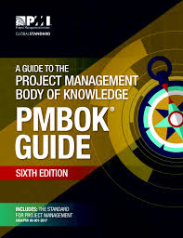




PMI Facts
470,000+ members
207 Countries
CAPM® | 33,880
PgMP® | 1,957
PMI-RMP® | 4,158
PMI-SP® | 1,710
PMI-ACP® | 16,283
(PfMP)® | 450
(PMI-PBA)® | 1,479
5+ million copies
774,000+
10,000+

Slide 14
PMI® – Membership Benefits
Get member’s only discount on many of PMI’s valuable products
Free Access to all PMI Standards
Subscriptions to PM Network®, Project Management Journal® and PMI Today™
Access the Members Area of the Web site
Access the PMI Member Community online
Notes:
Project Management Concepts
06/28/13
Version 3.1, 4/01 © 2003 by AstroWix
14
Project Management Institute
PMI is the largest, not-for-profit global professional association for project management practitioners with over 100,000 members worldwide which had been providing advancement of the profession of project management knowledge since 1969. The Institute can help provide tools professionals need to transform their organization. PMI is governed by a Board of Directors which is comprised of elected “volunteer” members of the organization. The Policies of the association are implemented through the professional staff who are located at the PMI Offices in Newtown Square, Pennsylvania in the United States of America.
PMI has a truly global membership, with representation in over 130 countries. Currently there are about 300 organizations participating in our Group Billing Plan. They have almost 300 chartered and potential Chapters working toward their charters. These Chapters act as “franchises” of PMI, providing education and networking opportunities to their members located in their regions or local areas. There are Specific Interest Groups, or SIGs, are designed to bring project management practitioners in similar industries or with similar interests together in a virtual environment.
There are currently 30 SIGs and 6 potential SIGs.
Member Benefits As a PMI member, you receive many valuable benefits that help to promote your professional and career development. These benefits include access to member’s only services as well as discounts on many of PMI’s valuable products. Member’s Only Service
Free Copy of the latest edition of the PMBOK® Guide CD ROM
Subscriptions to PM Network®, Project Management Journal® and PMI Today™
Join PMI’s Chapters, Specific Interest Groups (SIGs) and Colleges
Access the Members Area of the Web site
Access the PMI Member Community online
PMP Certification Benefits
For individuals, the PMP certification:
Provides professional and personal recognition
Expedites professional advancement
Creates job growth and opportunities within an organization
Provides a framework for standardized project management requirements
Increases an employee’s value to the organization
A major benefit that organizations can receive via the PMP Program is that the PMP is a truly global certification.
It is considered the profession’s most global credential because it is developed by a global network of PMPs who participate in the development of the examination and the program requirements.
With today’s multi-national companies, organizations can be assured that their PMP-certified project management practitioners are speaking the same language within the practice of project management.

Slide 15
PMP® – Certification Benefits
Provides professional and personal recognition
Expedites professional advancement
Creates job growth and opportunities within an organization
Provides a framework for standardized project management requirements
Increases an employee’s value to the organization
You have a truly global certification.
PMI Certified Project Managers are a preferred lot by any organizations worldwide
High Demand due to short supply of Certified PMP
Increase in compensation within the organization
Notes:
Project Management Concepts
06/28/13
Version 3.1, 4/01 © 2003 by AstroWix
15
Project Management Institute
PMI is the largest, not-for-profit global professional association for project management practitioners with over 100,000 members worldwide which had been providing advancement of the profession of project management knowledge since 1969. The Institute can help provide tools professionals need to transform their organization. PMI is governed by a Board of Directors which is comprised of elected “volunteer” members of the organization. The Policies of the association are implemented through the professional staff who are located at the PMI Offices in Newtown Square, Pennsylvania in the United States of America.
PMI has a truly global membership, with representation in over 130 countries. Currently there are about 300 organizations participating in our Group Billing Plan. They have almost 300 chartered and potential Chapters working toward their charters. These Chapters act as “franchises” of PMI, providing education and networking opportunities to their members located in their regions or local areas. There are Specific Interest Groups, or SIGs, are designed to bring project management practitioners in similar industries or with similar interests together in a virtual environment.
There are currently 30 SIGs and 6 potential SIGs.
Member Benefits As a PMI member, you receive many valuable benefits that help to promote your professional and career development. These benefits include access to member’s only services as well as discounts on many of PMI’s valuable products. Member’s Only Service
Free Copy of the latest edition of the PMBOK® Guide CD ROM
Subscriptions to PM Network®, Project Management Journal® and PMI Today™
Join PMI’s Chapters, Specific Interest Groups (SIGs) and Colleges
Access the Members Area of the Web site
Access the PMI Member Community online
PMP Certification Benefits
For individuals, the PMP certification:
Provides professional and personal recognition
Expedites professional advancement
Creates job growth and opportunities within an organization
Provides a framework for standardized project management requirements
Increases an employee’s value to the organization
A major benefit that organizations can receive via the PMP Program is that the PMP is a truly global certification.
It is considered the profession’s most global credential because it is developed by a global network of PMPs who participate in the development of the examination and the program requirements.
With today’s multi-national companies, organizations can be assured that their PMP-certified project management practitioners are speaking the same language within the practice of project management.

Slide 16
PMI Standards
Foundation Standards
PMBOK Guide 5th Edition, 2013/ 6th , 2016
Portfolio Management, 3rd Edition
Program Management, 3rd Edition
OPM3, 3rd Edition
Practice Standards
Practice Standard for Earn Value Management, 2nd
Practice Standard for Schedule Management, 2nd
Practice Standard for Risk Management
Practice Standard for Project Estimating
Practice Standard for Configuration Management
Practice Standard for Work Break Down Structure
Project Manager Competency Development Framework Profession
Practice Guides
Agile Practice Guide
Requirement Management Practice Guide
Governance of Portfolios, Program, Projects: A Practice Guide
Business Analysis for Practitioners: A Practice Guide
Implementing Organization Project Management: A Practice Guide
Navigation Complexity: A Practice Guide
Lexicon of Project Management Terms
Extensions
Construction Extension
Government Extensions

Slide 17
Certifications from PMI
Certified Associate in Project Management (CAPM)® certification
PMI Agile Certified Practitioner (PMI-ACP)® certification
PMI Risk Management Professional (PMI-RMP)® certification
PMI Scheduling Professional (PMI-SP)® certification
Portfolio Management Professional (PfMP) ® certification
Program Management Professional (PgMP)® certification
Project Management Professional (PMP)® certification
PMI Professional in Business Analysis (PMI-PBA)® certification

Slide 18
PMP Exam Prerequisite
Certification Body : PMI (Project Management Institute, USA)
35 contact hours of formal education
AND
Secondary degree (high school diploma, associate’s degree or global equivalent) +
Minimum five years/60 months unique non-overlapping professional project management experience during which at least 7,500 hours were spent leading and directing the project
OR
Four-year degree (bachelor’s degree or global equivalent) +
Minimum three years/36 months unique non-overlapping professional project management experience during which at least 4,500 hours were spent leading and directing the project*
Audit : PMP exam application gets audited randomly.

Slide 19
Exam Fees, Validity, Exam
Exam Fees : Fees for PMI members : $405, Fees for PMI non-members: $555
Re-Exam Fees : Fees for PMI members : $275, Fees for PMI non-members: $375
Renewal Fees : $60 (for members), $150 (for non-members). Certificate is valid for next three years.
Validity of certificate : Certificate is valid only for 3 years. Within 3 years certified person need to accumulate 60 PDUs and submit to PMI through online interface.
Exam : 4 hours. 200 questions. Close book exam. Passing Score not known. Online exam.

Slide 20
PMP Certification Process
Go through PMP training and get 35 Contact hours training
Get your experience data ready
Submit your application
Get your PMP application approved
Pay your PMI-Exam Fees
Book your exam at Prometric Center http://prometric.com/PMI
Write you exam & Pass

Slide 21
Questions Distribution in Exam
DOMAIN | % of Questions | # of Questions
Initiating | 13% | 26
Planning | 24% | 48
Executing | 31% | 62
Monitoring & Controlling | 25% | 50
Closing | 7% | 14
25 Questions are pre-test questions

Slide 22
Earning 60 PDU for Maintaining PMP
Before 3rd anniversary of your PMP certificate accumulate 60 PDU within 3 years and pay $60 (Members)/ $150 (Non-Members) to renew your certificate for another 3 years.

Slide 23
Ways to get 60 PDUs
Update your Project Management Knowledge
Attend some training on project management
Self paced on-line training on project management
Giving Back to society
Co-author PM book
Participate in Project Management Events
Write Paper /Article/ Blogs on PM
Speak on Project Management from PMI platforms
Conduct PM related trainings
Manage Projects using Project Management Methodolgoies

Slide 24
Benefits of Project Management
Meet business objectives;
Satisfy stakeholder expectations;
Be more predictable;
Increase chances of success;
Deliver the right products at the right time;
Resolve problems and issues;
Respond to risks in a timely manner;
Optimize the use of organizational resources;
Identify, recover, or terminate failing projects;
Manage constraints (e.g., scope, quality, schedule, costs, resources);
Balance the influence of constraints on the project (e.g., increased scope may increase cost or schedule); and
Manage change in a better manner.

Slide 25
Top 10 Reasons NOT to Use Project Management
10. Our customers really love us, so they don't care if our products are late and don't work.
09. Organizing to manage projects isn't compatible with our culture, and the last thing we need around this place is change.
08. All our projects are easy, and they don't have cost, schedule, and technical risks anyway.
07. We smart enough to deliver successfully without these this extra work
06. We might have to understand our customers' requirements and document a lot of stuff, and that is such last thing we want to do.
05. Project management requires integrity and courage, who will pay for this?
04. Our bosses won't provide the support needed for project management; they want us to get better results through magic.
03. Once we start we have to apply same project management processes blindly to all projects regardless of size and complexity, this is unfair, better not do adopt this.
02. I know there is a well-developed project management body of knowledge, but I my project mess is too different, so next project..
01. We have found it's more profitable to have 50% overruns than to spend 10% on project management to fix them.

Slide 26
Project Management Framework

Slide 27
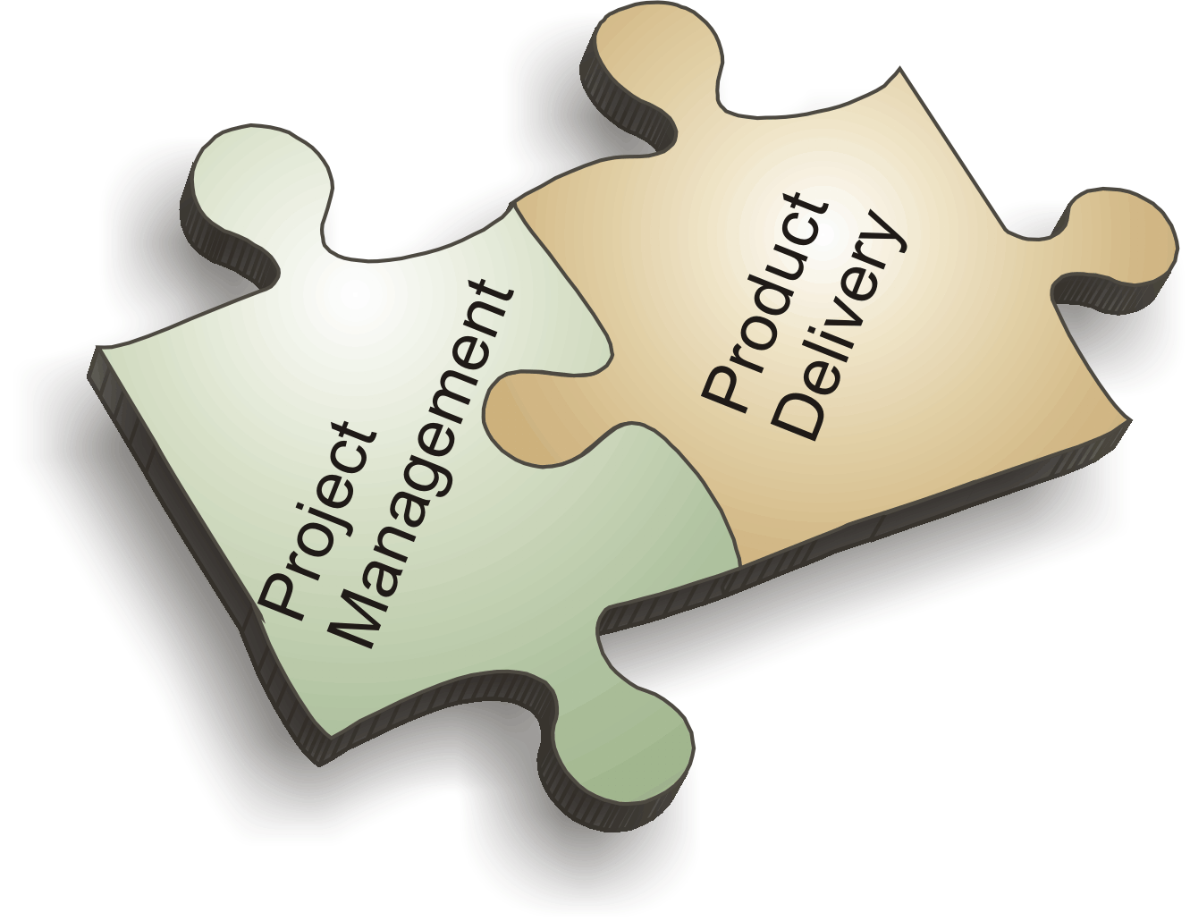

Slide 28
Topics
Project
Operations
Project Constraints
Project Phases, Milestones, Deliverables, Activities
Project Lifecycle (PLC) & Level of Activities
Typical Costing & Staffing across PLC
Risk, Cost of Change in PLC
Project Boundary
Relationship between Process Group & Phases
Project Management
Program Management
Portfolio Management
Program Management Office
Project Stakeholders
Stakeholder Register
Organization Types & Influence of Project Success
Project Management Methodologies
Configuration Management
Progressive Elaboration
Rolling Wave Planning
Project Documents
Business Documents
Project Management Plan
Organizational Process Assets
Enterprise Environmental Factors
Project Selection Criteria
Project Manager Responsibilities
Project, Program, Portfolio Overview
Tools & Techniques : 9 Data Gathering
T&T : 27 Data Analysis
T&T : 15 Data Representation
T&T : 2 Decision Making
T&T : 17 Interpersonal & Team Skill
Expert Judgement
Meetings
Project Management Knowledge Areas
Process Groups

Slide 29
What is Project???

Slide 30
What is Project?
Project – A temporary endeavor undertaken to create a unique product, service or result
How Temporary?
Has a definite beginning and end, not an on-going effort
Ceases when objectives have been attained
Team is disbanded upon project completion
Unique?
The product or service is different in some way from other product or services
Product characteristics are progressively elaborated

Slide 31
Project has…
Project Characteristics
Goal (measurable/verifiable) Oriented
Finite duration with a beginning and end
Uniqueness to a great extent and related uncertainties
Coordinated undertaking of interrelated activities
Performing the activities involve resources
Resources cost money

Slide 32
Source of Project?
Need for improvement
Market Competition
Strategic/ Mission/ Vision
Government Regulation
Environmental Forces

Slide 33
“Projects” different from “operations”?
Contrast Projects & Operations
Projects
Permanent Project Charter
Catalyst for change
Unique product or service
Heterogeneous teams
Start and end date
Progressive elaboration
Operations
Semi-permanent charter
Maintains status quo
Standard product or service
Homogeneous teams
Ongoing
Predefined product

Slide 34






Project Constraints
Risk
Scope
Project and Product Quality
Schedule
Cost
Resource

Slide 35
Project Phases
Project Phases
Projects are divided into phases where extra control is required to effectively manage the completion of the major deliverables
Collectively, the project phases put together is known as Project life cycle
Each phase is marked by one or more tangible verification work product
The conclusion of a project phase is generally marked by a review
The phase end points are referred to as phase exits, milestones, phase gates, decision gates, stage gates or kill points
Starting a phase before approval of deliverables of a previous phase is called Fast Tracking
Phases are not cyclical they are sequential
Phases are not deliverables but deliverables are part of a Phase
E.g. Product Feasibility, Product Prototyping, Product Design, Development, System Testing, Deployment, Concept development, Customer requirements, Solution development, Build, Test, Transition, Commissioning

Slide 36
Milestones, Deliverables
Deliverables
Work product, product component developed by the project team
E.g. Wireframe, Database ER Diagrams, Sequence Diagram, Test Case, Test Results, Any Feature of the Product.
Milestone
Zero Duration Activity. Mark of Completion of some set of activities with deliverables
E.g. Design Complete, Security Testing Complete, Requirement Gathering Complete, Quality Audit Complete, Development Complete, Deployment Complete

Slide 37
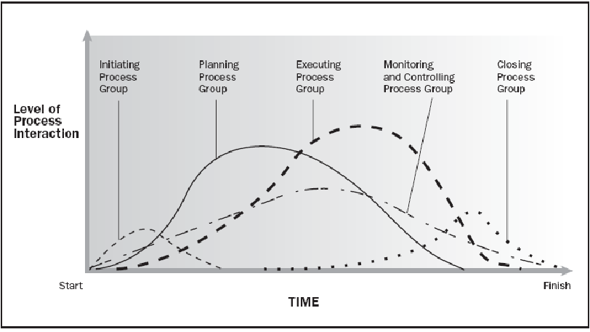
Project Lifecycle (PLC) & Level of Activities
Source PMBOK Guide Version 6.0

Slide 38
Project vs Development Lifecycle
Project life cycles can be predictive or adaptive. Within a project life cycle, there are generally one or more phases that are associated with the development of the product, service, or result. These are called a development life cycle.
Development life cycles can be predictive, iterative, incremental, adaptive, or a hybrid model

Slide 39
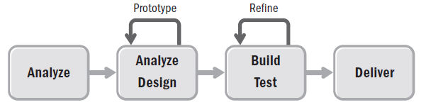
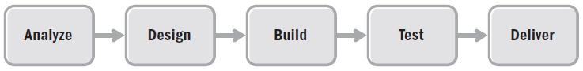
Iterative vs Predictive Life Cycles

Slide 40
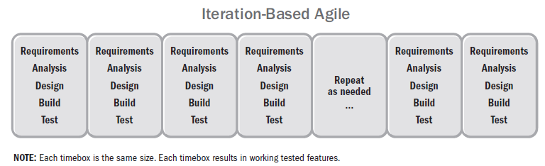
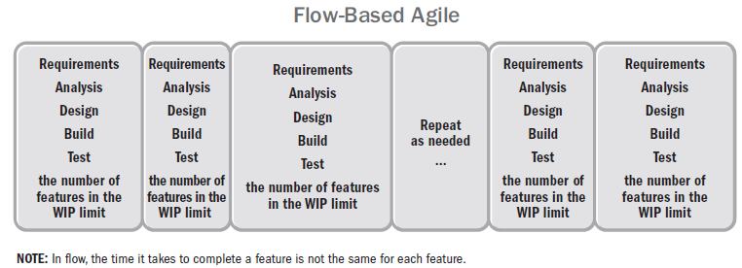
Change Driven Life Cycle

Slide 41
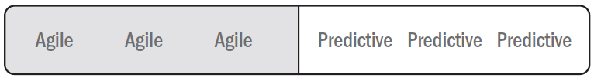
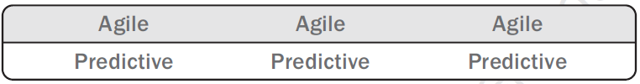
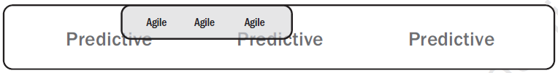

Hybrid Life Cycle

Slide 42
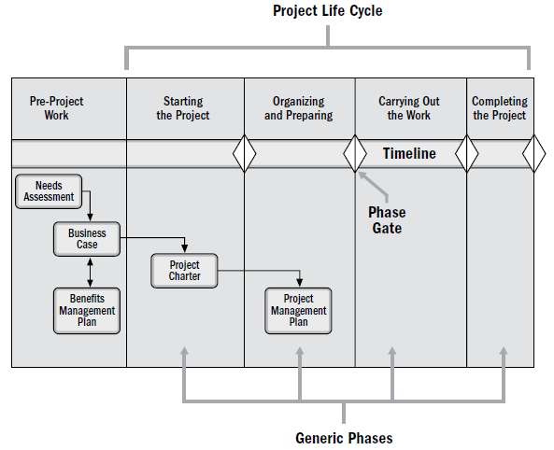
Typical Project Lifecycle
Source PMBOK Guide Version 6.0

Slide 43
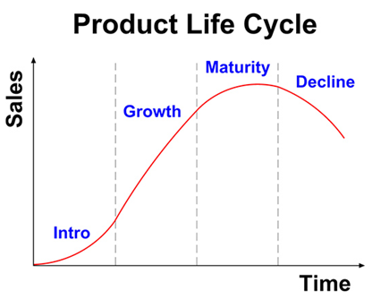
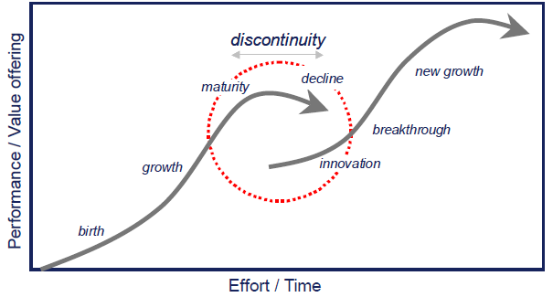
Product Life Cycle

Slide 44
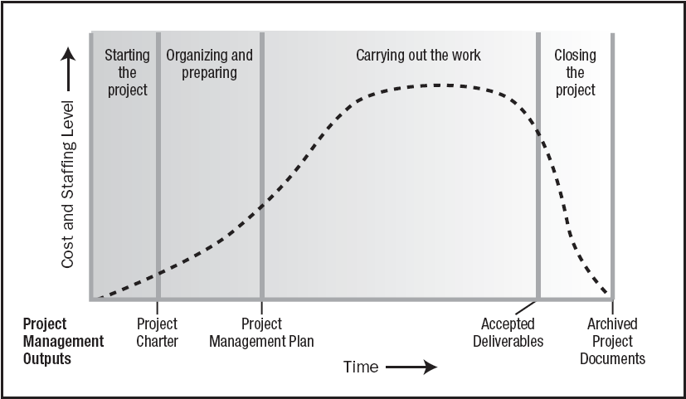
Typical Costing & Staffing across PLC
Source PMBOK Guide Version 6.0

Slide 45
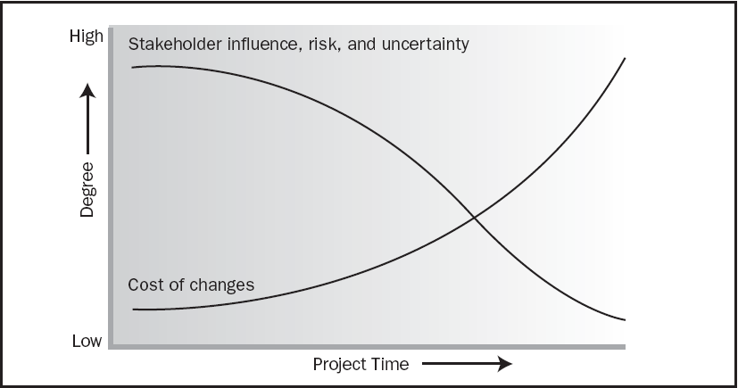
Risk, Cost of Change in PLC
Source PMBOK Guide Version 6.0

Slide 46
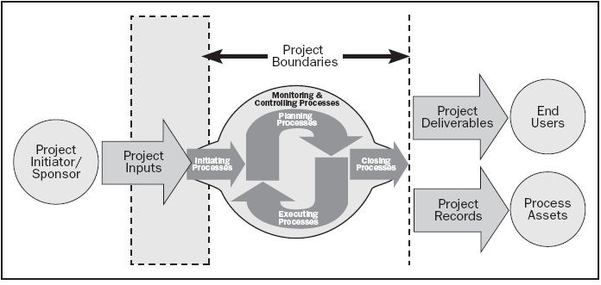
Project Boundaries are Important!
Project Boundaries
Source PMBOK Guide Version 6.0

Slide 47
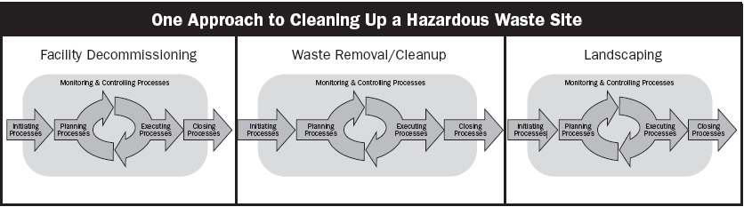
Relationship between Process Group & Phases
Source PMBOK Guide Version 6.0

Slide 48
Project Management
Project Management
The application of knowledge, skills, tools and techniques to project activities in order to meet the project requirements

Slide 49
What is Program?
Project Management Context
Group of related projects managed in a coordinated way to obtain the benefits and control which will not be possible from managing them individually
Scope is least important. Benefit(s) are primary goal. Program manager is not responsible for delivery but for benefit realization. Addition/removal of projects in a program is in the hand of Program Manager
Several projects are required under a program because of different technology, different skills & different kind of teams, parallel work, different type of deliverables.
e.g. Bringing a new product (from conceptualization to Sale all project), New satellite in space, Health improvement of a cancer patient. An IT company want to enter into new market with Cloud Services for the customer.

Slide 50
Project Portfolio Management
Project Management Context
Collection of projects or programs and other work that are grouped together to facilitate effective management of that work to meet strategic business objectives
CEO (Mission/Vision)
Strategy
Portfolios
A Consumer Electronics Company
Laptop
TV
Servers
OS
Health
Education
Rehabilitation
An NGO

Slide 51
Relationship Between PPP
CEO
Portfolio 1
Portfolio 2
Program 1
Project A
Sub Portfolio 1-1
Sub Portfolio 1-2
Program 3
Program 2
Project 3
Project 4
Project 1
Project 2

Slide 52
PPP Overview
 | Project | Program | Portfolio
Definition | Temporary endeavor- unique P/S/R | Group of related projects, sub-prog, prog-activities to obtain benefits | Collection of Project/Prog/Sub-Portfolio/Operation to achieve strategic objective
Scope | Defined objective. Scope progressive elaborate. | Output and outcome of program component produce benefits to the org. | Changes with the change of org strategic objective
Change | Manage change in output | Manage changes in benefits from prog components | Manage changes in external/internal environment and impact on strategy
Planning | Plan progressively with high level plan | High level to track inter-dependencies of prog components. Guide for proj planning | Process to aggregate portfolio from program and project
Management | Project Team | Coordinating between project team to ensure program benefits | Portfolio staff which coordinate to aggregate results for portfolio
Monitoring | Monitor and Control the work which produce unique P/S/R | Monitor and Control the work which ensure program goal, objective, schedule, budget, benefits | Monitor and Control strategic change and resource allocation
Success | Cost, Time, Quality, Customer Satisfaction | Ability to deliver intended benefits in efficient way | ROI

Slide 53
What is PMO?
Project Management Office
Managing shared resources across all project administered by PMO
Identifying and developing project management methodology, best practices and standards
Coaching, mentoring, training and oversight
Monitoring compliance with project management standards, policies, procedures and templates via project audits
Developing and managing project policies, procedures, templates and other shared documentation (organizational process assets), and
Coordinating communication across projects

Slide 54
Who are Stakeholders?
Stakeholders
Persons or organizations who are actively involved in the project or whose interests maybe positively or negatively affected by the performance or completion of the project
Source PMBOK Guide Version 6.0

Slide 55
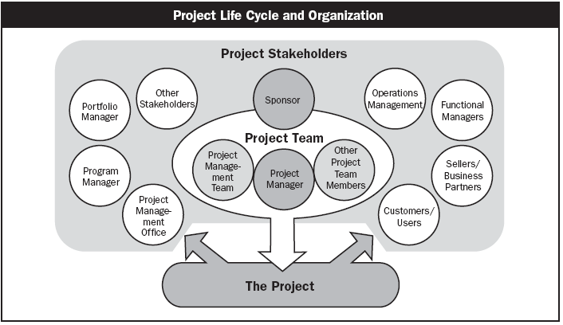
Stakeholders
Source PMBOK Guide Version 6.0

Slide 56
Stakeholder Register
ID
Name
Department
Internal vs External
Designation
Manager
Power (1-10)
Interest (1-10)
Current Position (Favorable, Against, Neutral)
Needed Position
Person Attributes (food, philosophy, ideology etc)
Person Preferences
Contact Details

Slide 57
Organizational Types
Functional
Matrix
Weak Matrix
Balanced Matrix
Strong matrix
Projectized

Slide 58
Functional
Chief Executive
Project Coordination
Functional Manager
Functional Manager
Functional Manager
Staff
Staff
Staff
Staff
Staff
Staff
Staff
Staff
Staff

Slide 59
Weak Matrix
Chief Executive
Functional Manager
Functional Manager
Functional Manager
Staff
Staff
Staff
Staff
Staff
Staff
Staff
Staff
Staff
Project Coordination

Slide 60
Balance Matrix
Chief Executive
Functional Manager
Functional Manager
Functional Manager
Staff
Staff
Staff
Staff
Staff
Staff
Project Manager
Staff
Staff
Project Coordination

Slide 61
Strong Matrix
Chief Executive
Functional Manager
Functional Manager
Functional Manager
Manager of Project Managers
Staff
Staff
Staff
Project Manager
Staff
Staff
Staff
Project Manager
Staff
Staff
Staff
Project Manager
Project Coordination

Slide 62
Projectized Matrix
Project Coordination
Chief Executive
Project Manager
Project Manager
Project Manager
Staff
Staff
Staff
Staff
Staff
Staff
Staff
Staff
Staff

Slide 63
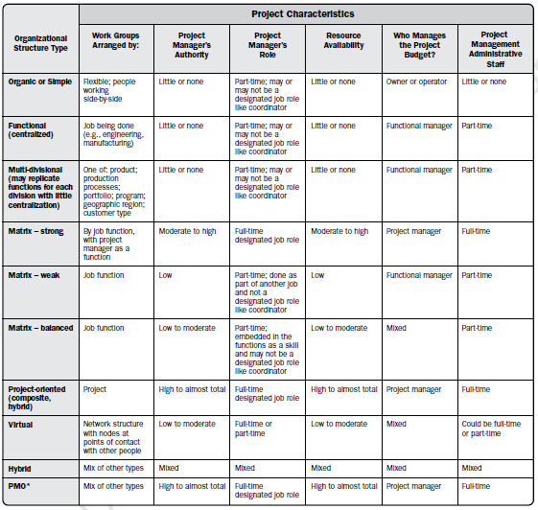
Organizational Influence
Source PMBOK Guide Version 6.0

Slide 64
Configuration Management System
A system to manage project artifacts, project’s product and project’s product’s components.
It helps in versioning, naming, storing, archiving, backup, securing project and product output.
e.g. SVN, VSS, TFS

Slide 65
Project Documents
Documents being managed by the project team to perform the project
Document provided by customers, vendors, government agencies, management
Documents which are prepared by the team like Design Related, Requirement Related, Issue Register, Risk Register, Change Log
All document must be managed using some Configuration Management Tool.

Slide 66
Project Documents
Activity attributes
Activity list
Assumption log
Basis of estimates
Change log
Cost estimates
Cost forecasts
Duration estimates
Issue log
Lessons learned register
Milestone list
Physical resource assignments
Project calendars
Project communications
Project schedule
Project schedule network diagrams
Project scope statement
Project team assignments
Quality control measurements
Quality metrics
Quality reports
Requirements documentation
Requirements traceability matrix
Resource breakdown structure
Resource calendars
Resource requirements
Risk register
Risk report
Schedule data
Schedule forecasts
Stakeholder register
Team charter
Test and evaluation documents

Slide 67
Project Management Plan
Project Management Plan includes
All Subsidiary Plan (Configuration, Cost, Risk etc)
All Baselines Related to Project
Project Management Methodology
Project Lifecycle and Project Phases
Process Tailored List
Tailored Process

Slide 68
Project Management Plan
Scope management plan
Requirements management plan
Schedule management plan
Cost management plan
Quality management plan
Resource management plan
Communications management plan
Risk management plan
Procurement management plan
Stakeholder engagement plan
Change Management Plan
Configuration Management Plan
Performance measurement baseline
Development approach
Project life cycle description
Management Reviews
Scope baseline
Schedule baseline
Cost baseline

Slide 69
Business Documents
Agreements
Bid documents
Benefits Management Plan.
Independent cost estimates
Project charter
Final report
Make-or-buy decisions
Procurement statement of work
Procurement strategy
Project funding requirements
Team performance assessments
Work performance data
Work performance information
Work performance reports
Change requests

Slide 70
Project Benefits Management Plan
Target benefits (e.g., the expected tangible and intangible value to be gained by the implementation of the project; financial value is expressed as net present value);
Strategic alignment (e.g., how well the project benefits align to the business strategies of the organization);
Timeframe for realizing benefits (e.g., benefits by phase, short-term, long-term, and ongoing);
Benefits owner (e.g., the accountable person to monitor, record, and report realized benefits throughout the timeframe established in the plan);
Metrics (e.g., the measures to be used to show benefits realized, direct measures, and indirect measures);
Assumptions (e.g., factors expected to be in place or to be in evidence); and
Risks (e.g., risks for realization of benefits).

Slide 71
Other Types of Outputs
Approved change requests
Closed procurements
Selected sellers
Source selection criteria
Deliverables
Verified deliverables
Accepted deliverables
Final product, service, or result transition
Project documents updates
Organizational process assets updates
Procurement documentation updates
Enterprise environmental factors updates

Slide 72
Subsidiary Plan
Subsidiary plan need to be developed for each aspect of the project. For every aspect (Scope, Time, Cost, Quality, Resources, Communication, Risk, Stakeholder) you need to know following
What are the activities which need to be done?
Who will perform these? Is any training required to perform these activities.
When these activities will be performed?
How will you measure success?
What tool you will use for this?
How will you execute the work of this aspect?
How will you control this aspect?
Most of these activities are related to Planning of the Plan and NOT of the planning of Execution

Slide 73
Organizational Process Assets
Process Assets which created by the organization while doing the project in past
Processes, Standards, Guidelines, Checklist, Templates standardized by the Quality Department or PMO
Lessons learned report of the previous projects
Consider them for project Initiation, Planning, Executing, Monitoring & Controlling and Closing. Do not reinvent the wheel in project management.
e.g. Time/Cost/Resource Estimation database, Risk database, Issue Register, Skills Database

Slide 74
Enterprise Environmental Factors
Constraints which are not in control of a Project Manager and the project manager has to consider them to make project successful.
These constraints are imposed by environment of those enterprises which are involved in the project
Consider them for project Initiation, Planning, Executing, Monitoring & Controlling and Closing
e.g. Skill Availability, Market Condition, Attitude of People, Organization Culture, Climatic Condition, Political Condition, Bosses etc.

Slide 75
Progressive Elaboration
Project scope unfolds during the project execution. Scope of the next phase depends upon the output or success of previous phase.
It is Scope Management Concept.

Slide 76
Rolling Wave Planning
Activities of any deliverable can be known when we know what need to delivered.
Attribute of the activities can be known only when we know what are the activities and what is deliverable.
It is Time Management Concept.

Slide 77
Project Management Information Systems (PMIS)
Electronic project management tools. Project management software, meeting and virtual office support software, web interfaces, specialized project portals and dashboards, and collaborative work management tools.
Electronic communications management. Email, fax, and voice mail; audio, video and web conferencing; and websites and web publishing.
Social media management. Websites and web publishing; and blogs and applications, which offer the opportunity to engage with stakeholders and form online communities.

Slide 78
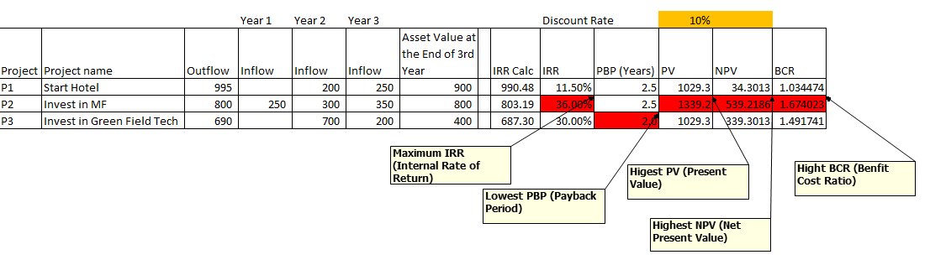
Project Selection Criteria
PBP- Payback Period is a time in which original invest is realized.
PV = FV / (1+ r)^n
PV= Present Value
FV= Future Value
r = Discount Rate
n = Number of Years
NPV = Inflow – Outflow (Take Positive Value)
IRR = A discount rate at which [Outflow – Inflow =0 ]
BCR = Benefits (Present Value) / Cost (Output)

Slide 79
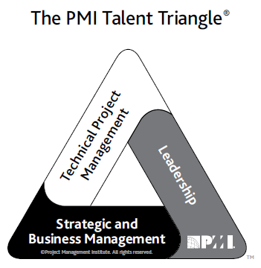
PMI Talent Triangle
Technical project management. The knowledge, skills, and behaviors related to specific domains of project, program, and portfolio management. The technical aspects of performing one’s role.
Leadership. The knowledge, skills, and behaviors needed to guide, motivate, and direct a team, to help an organization achieve its business goals.
Strategic and business management. The knowledge of and expertise in the industry and organization that enhanced performance and better delivers business outcomes.
Source PMBOK Guide Version 6.0

Slide 80
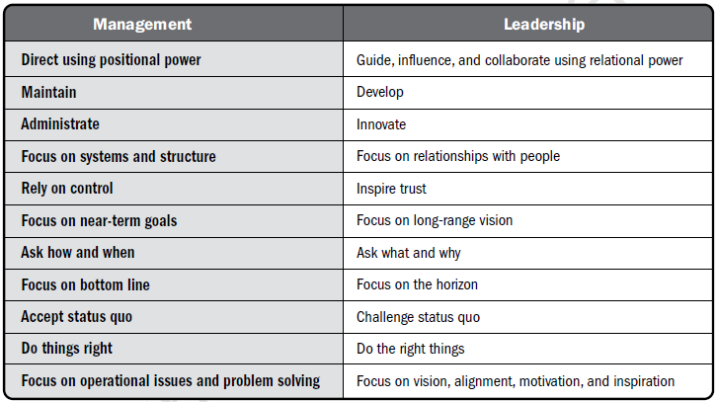
Management & Leadership
Source PMBOK Guide Version 6.0

Slide 81
PM Competencies
A Framework
Project Manager Competency Development Framework- 2nd Edition, 2007

Slide 82

Project Manager Responsibilities
Project Manager’s Role
Estimates of size, efforts & schedule
Risk identification, analysis, prioritization, monitoring & control
Resource allocation, resource backup and utilization
Scope management
Communication- reviews, steering committee meetings, stakeholder identification and expectation management
Stakeholder Expectation Management
Defect free product delivery on time within budget
Team motivation, team management, training & development, appreciation, career planning, interview
Deliver as per contract & proposal
Procure as per contract & proposal
Configuration management, data backup
Quality planning
Cost optimization
Presales & proposals
Technical guidance to team – if team members are not available do their work (after project manager has completed his work & he has spare time)

Slide 83
Project Manager Responsibilities
Project Manager’s Responsibilities in Project Lifecycle
Initiating a Project
Project aligned with org objectives & customer needs
High-level risks, assumptions and constraints are understood
Stakeholders identified and their need are understood
Project Charter approved
Planning a Project
Project scope agreed
Project schedule approved
Cost budget approved
Project team identified with roles and responsibilities agreed
Communication activities agreed
Quality management process established
Risk response plan approved
Integrated change control processes defined
Procurement plan approved
Project Plan approved

Slide 84
Project Manager Responsibilities
Project Manager’s Responsibilities in Project Lifecycle
Executing a Project
Project scope achieved
Project stakeholders expectations managed
Human resource managed
Quality managed against plan
Material resources managed
Monitoring & Controlling a Project
Project tracked and status communicated to stakeholders
Project change is managed
Quality is monitored and controlled
Risk is monitored and controlled
Project team managed
Contract administered
Closing a Project
Project outcomes accepted
Project resources released
Stakeholder perceptions measured and analyzed
Project formally closed

Slide 85
Project Manager Competencies
Personal Competence
Communication
Leading
Managing
Cognitive Ability
Effectiveness
Professionalism

Slide 86
Widely Used Tools & Techniques in PMBOK 6th Ed

Slide 87
Data Gathering Tools and Techniques
Benchmarking
Brainstorming
Check-sheets
Checklists
Focus-groups
Interviews
Market-research
Questionnaires-and-surveys
Statistical-sampling

Slide 88
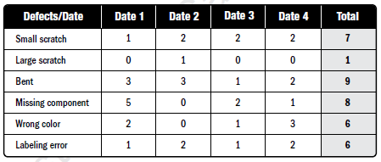
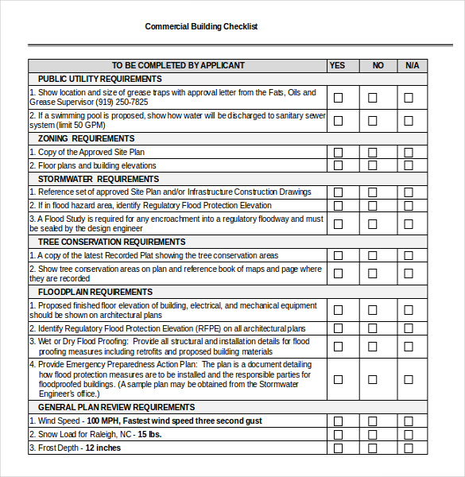

Data Gathering
Checklists
Check-sheets
Focus groups bring together prequalified stakeholders and subject matter experts to learn about their expectations and attitudes about a proposed product, service, or result. A trained moderator guides the
group
Focus-groups

Slide 89
Data Analysis Tools and Techniques
Alternatives-analysis
Assessment of other risk parameters
Assumption and constraint analysis
Cost of quality
Cost-benefit analysis
Decision tree analysis
Document analysis
Earned value analysis
Influence diagrams
Iteration burndown chart
Make-or-buy analysis
Performance reviews
Process analysis
Proposal evaluation
Regression analysis
Reserve analysis
Risk data quality assessment
Risk probability and impact assessment
Root cause analysis
Sensitivity analysis
Simulation
Stakeholder analysis
SWOT analysis
Technical performance analysis
Trend analysis
Variance analysis
What-if scenario analysis

Slide 90
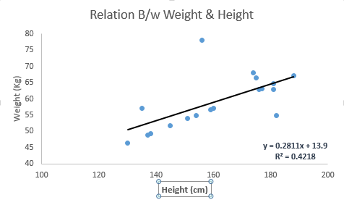
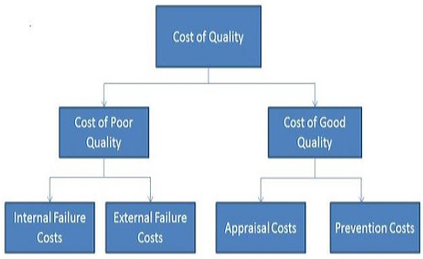
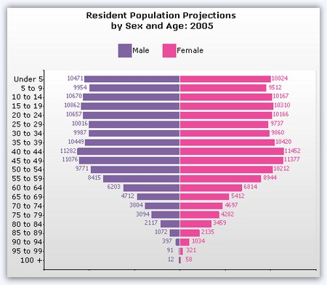
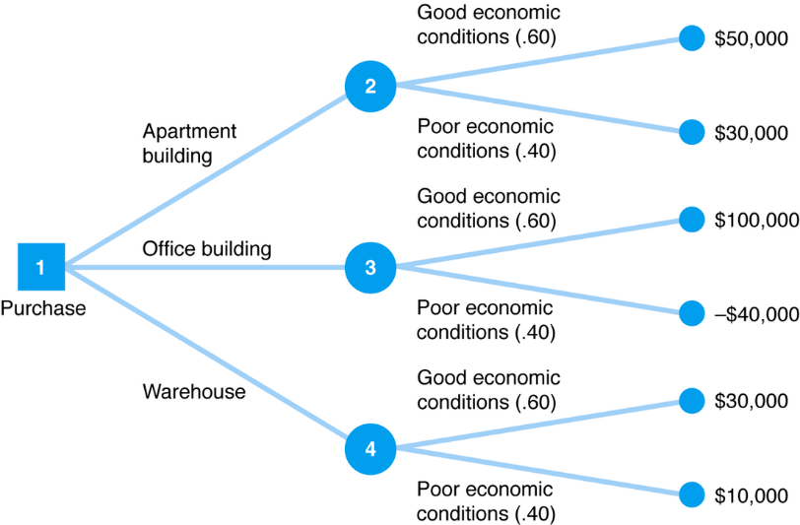
Data Analysis
Cost of quality
Regression analysis
Sensitivity analysis
Decision tree analysis

Slide 91
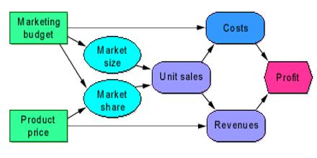
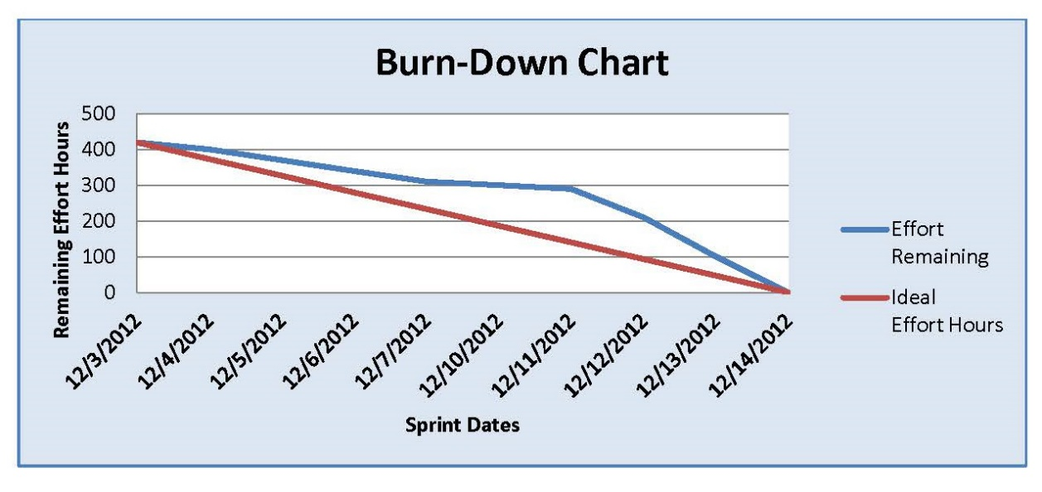
Data Analysis
Influence diagrams
Iteration burndown chart

Slide 92
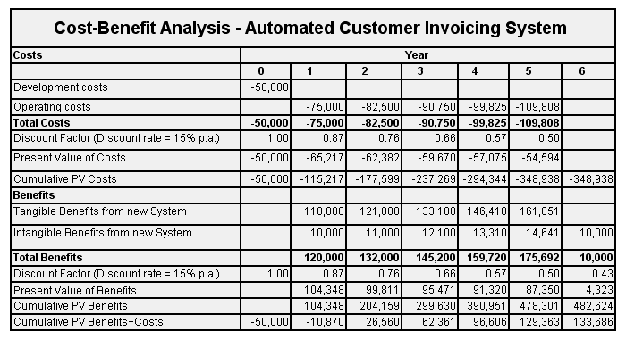
Data Analysis
Cost-benefit analysis

Slide 93
Data Representation Tools and Techniques
Affinity diagrams
Cause-and-effect diagrams
Control charts
Flowcharts
Hierarchical charts
Histograms
Logical data model
Matrix diagrams
Matrix-based charts
Mind mapping
Probability and impact matrix
Scatter diagrams
Stakeholder engagement assessment matrix
Stakeholder mapping/ representation
Text-oriented formats

Slide 94
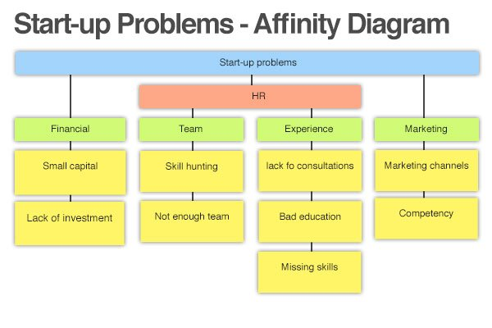
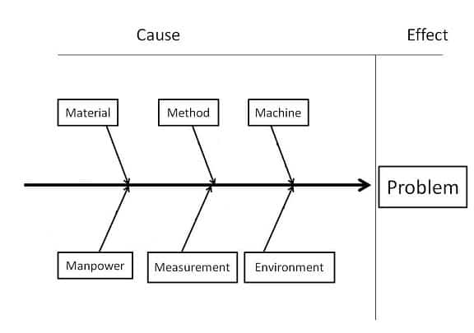
Data Representation
Cause-and-effect diagrams

Slide 95
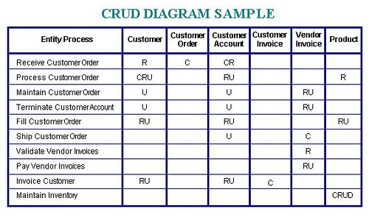
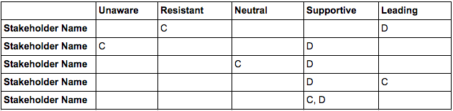
Data Representation
Matrix diagrams
C-Current, D-Desired
Stakeholder engagement assessment

Slide 96
Decision-Making Tools and Techniques
Multicriteria decision analysis
Prioritization matrix. Identify criteria. Criteria are prioritized and weighted before being applied to all available alternatives to obtain a mathematical score for each alternative.
Voting
Unanimity, Majority, Plurality

Slide 97
Communication Skills Tools and Techniques
Feedback
Interactive Communication like Coaching, Mentoring, and Negotiating
Presentations

Slide 98
Interpersonal and Team Skills Tools and Techniques
Active listening
Communication styles assessment
Conflict management
Cultural awareness
Decision making
Emotional intelligence
Facilitation
Influencing
Leadership
Meeting management
Motivation
Negotiation
Networking
Nominal group technique
Observation/ conversation
Political awareness
Team building

Slide 99
Nominal Group Technique
The nominal group technique enhances brainstorming with a voting process used to rank the most useful ideas for further brainstorming or for prioritization. The nominal group technique is a structured form of brainstorming consisting of four steps:
Question or problem is posed, idea silently generated
Moderator writes down the ideas
Each recorded idea is discussed
Individuals vote privately to prioritize the ideas

Slide 100
Expert Judgement
Being an industry neutral, domain neutral, culture neutral standard PMBOK provides you a unique tool to deliver a successful project. This tool is called expert judgment.
Project managers highly rely on industry specific skills, input from local market experts, those who have done similar work earlier
E.g. SME, A department within Organization, Industry Group, Consultants, Experienced People within Org or Industry

Slide 101

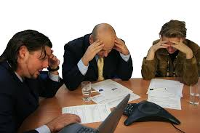
Meetings
Meetings with stakeholders helps us understand their viewpoint which is critical for making decisions.
F2F
Virtual
Formal
Informal
Standup Meeting
Kickoff Meetings
Adhoc Meeting
Review Meeting
Off-site Meetings
On-Site Meeting

Slide 102


Project Management Knowledge Areas
7- Communication
Project Manager
2- Scope
1- Integration
6- Resources
3-Time
9- Procurement
4- Cost
10- Stakeholders
5- Quality
8- Risk

Slide 103


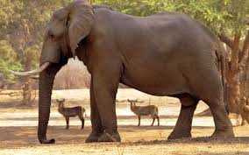


Process Groups
Monitoring & Controlling
Executing
Initiating
Planning
Closing

Slide 104
Process is not
Plan (Schedule MP, Risk MP, Procurement MP etc.)
Methodology (Agile, Lean, Scrum etc)
Body of knowledge (PMBoK, OMBoK, BABoK etc)
Library (ITIL)
Model (CMMI, OPM3, ISO)
Standard (IEEE standard)
Checklist (Code review, Design Review, Readiness Review)
Manual (QMS, OMS, HR Manual)
Law (traffic law, criminal law, gravitational law)
Framework (PRINCE2 or other technical or development)
Knowledge area (IM, SM, TM etc)
Process area (RD, REQM, PP, TS, VER etc)
Best practice (Standup meeting, TDD, Requirement Prioritization, Product Backlog, Sprint Planning)
Tailored process and OSSP are different

Slide 105
What is PMBOK?
PMBOK® is a Guide. It is different from a methodology. A methodology is a system of practices, techniques, procedures, and rules used by those who work in a discipline.
It is a foundation for organizations on which they can build methodologies, policies, procedures, rules, tools and techniques, and life cycle phases needed to practice project management

Slide 107
Project Integration Management

Slide 108
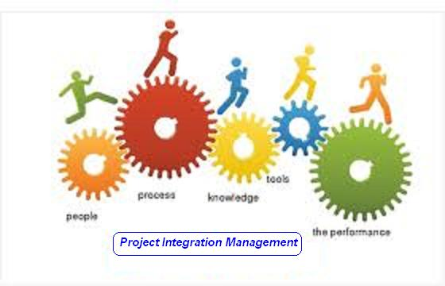

Slide 109
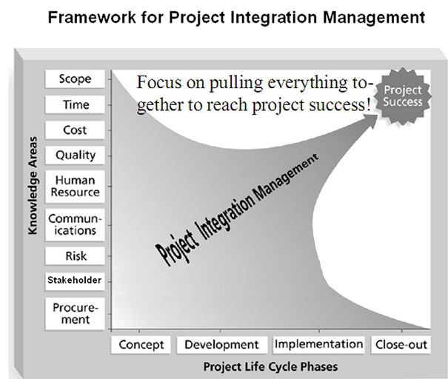

Slide 110
Project Integration Management
Processes and activities needed to identify, define, combine, unify, and coordinate the various processes and project management activities within the Project Management Process Groups

Slide 111
Project Integration Management
Develop Project Charter [INITIATING]
Develop Project Management Plan [PLANNING]
Direct and Manage Project Execution [EXECUTING]
Manage Project Knowledge [EXECUTING]
Monitor and Control Project Work [M&C]
Perform Integrated Change Control [M&C]
Close Project or Phase [CLOSING]

Slide 112
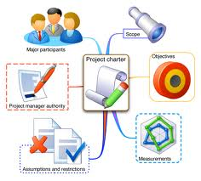
1. Develop Project Charter
The process of developing a document that formally authorizes the existence of a project and provides the project manager with the authority to apply organizational resources to project activities.

Slide 113
Develop Project Charter
PIM
INIT
.1 Business documents
• Business case
• Benefits management plan
.2 Agreements
.3 EEFs
.4 OPA
.1 Expert judgment
.2 Data gathering
• Brainstorming
• Focus groups
• Interviews
.3 Interpersonal and team skills
• Conflict management
• Facilitation
• Meeting management
.4 Meetings
.1 Project charter
.2 Assumption log

Slide 114
Project Charter Template
Project purpose or justification
Measurable project objectives and related success criteria
High – Level Requirements
High – Level Project description
High – Level Risks
Summary milestone schedule
Summary Budget
Project approval requirements
Assigned project manager, responsibility, and authority level
Name and authority of the sponsor or other person(s) authorizing the project charter

Slide 115
Exercise-1
15 Minutes
Prepare Project Charter for your Project

Slide 116

2. Develop Project Management Plan
The process of defining, preparing, and coordinating all plan components and consolidating them into an integrated project management plan.

Slide 117
Develop Project Management Plan
PIM
PLAN
.1 Project charter
.2 Outputs from other processes
.3 EEFs
.4 OPAs
.1 Expert judgment
.2 Data gathering
• Brainstorming
• Checklists
• Focus groups
• Interviews
.3 Interpersonal and team skills
• Conflict management
• Facilitation
• Meeting management
.4 Meetings
.1 Project management plan

Slide 118
Exercise-2
5 Minutes
Write name of all type of subsidiary plans for your Project

Slide 119

3. Direct & Manage Project Work
The process of leading and performing the work defined in the project management plan and implementing approved changes to achieve the project’s objectives.

Slide 120
Direct and Manage Project Work
PIM
EXEC
.1 Project management plan
• Any component
.2 Project documents
• Change log
• Lessons learned register
• Milestone list
• Project communications
• Project schedule
• RTM
• Risk register
• Risk report
.3 Approved change requests
.4 EEFs
.5 OPAs
.1 Expert judgment
.2 PMIS
.3 Meetings
.1 Deliverables
.2 Work performance data
.3 Issue log
.4 Change requests
.5 PMP updates
• Any component
.6 Project documents updates
• Activity list
• Assumption log
• Lessons learned register
• Requirements Docs.
• Risk register
• Stakeholder register
.7 OPAs Updates

Slide 121
Exercise-3
5 Minutes
Write name of Deliverables & Name of work performance information for your Project

Slide 122

4. Manage Project Knowledge
The process of using existing knowledge and creating new knowledge to achieve the project’s objectives and contribute to organizational learning.

Slide 123
Manage Project Knowledge
PIM
EXEC
.1 PMP
• All components
.2 Project documents
• Lessons learned register
• Project team assignments
• Resource breakdown structure
• Source selection criteria
• Stakeholder register
.3 Deliverables
.4 EEFs
.5 OPAs
.1 Expert judgment
.2 Knowledge management
.3 Information management
.4 Interpersonal and team skills
• Active listening
• Facilitation
• Leadership
• Networking
• Political awareness
.1 Lessons learned register
.2 PMP updates
• Any component
.3 OPAs updates

Slide 124
Knowledge Management
Connect people so they can work together to create new knowledge & share tacit knowledge & integrate the knowledge of diverse team members.
Networking
Conversations with specialists;
Communities of practice
Meetings
Work shadowing and reverse shadowing;
Discussion forums
Knowledge-sharing events such as seminars and conferences;
Workshops, including problem-solving sessions and learning reviews designed to identify lessons learned;
Storytelling;
Creativity and ideas management techniques;
Knowledge fairs and cafés; and
Training that involves interaction between learners.

Slide 125
Information management
That connect people to information. Effective for sharing simple, unambiguous, codified explicit knowledge.
Methods for codifying explicit
Lessons learned register
Web searches and reading published articles;
PMIS

Slide 126
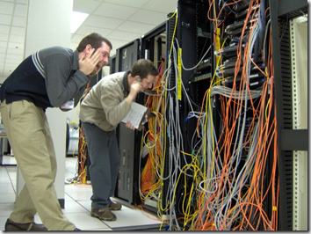
5. Monitor & Control Project Work
The process of tracking, reviewing, and reporting overall progress to meet the performance objectives defined in the project management plan.

Slide 127
Monitor and Control Project Work
PIM
M&C
.1 Project management plan
• Any component
.2 Project documents
• Assumption log
• Basis of estimates
• Cost forecasts
• Issue log
• Lessons learned register
• Milestone list
• Quality reports
• Risk register
• Risk report
• Schedule forecasts
.3 Work performance information
.4 Agreements
.5 EEFs
.6 OPA
.1 Expert judgment
.2 Data analysis
• Alternatives analysis
• Cost-benefit analysis
• Earned value analysis
• Root cause analysis
• Trend analysis
• Variance analysis
.3 Decision making
.4 Meetings
.1 Work performance reports
.2 Change requests
.3 PMP updates
• Any component
.4 Project documents updates
• Cost forecasts
• Issue log
• Lessons learned register
• Risk register
• Schedule forecasts

Slide 128
Exercise-4
5 Minutes
Write type & name of a few change requests for your Project

Slide 129

6. Perform Integrated Change Control
The process of reviewing all change requests; approving changes and managing changes to deliverables, organizational process assets, project documents, and the project management plan; and communicating the decisions.

Slide 130
Perform Integrated Change Control
PIM
M&C
.1 PMP
• Change management plan
• Configuration management plan
• Scope baseline
• Schedule baseline
• Cost baseline
.2 Project documents
• Basis of estimates
• RTM
• Risk report
.3 Work performance reports
.4 Change requests
.5 EEFs
.6 OPAs
.1 Expert judgment
.2 Change control tools
.3 Data analysis
• Alternatives analysis
• Cost-benefit analysis
.4 Decision making
• Voting
• Autocratic decision making
• Multicriteria decision analysis
.5 Meetings
.1 Approved change requests
.2 PMP updates
• Any component
.3 Project documents updates
• Change log

Slide 131
Exercise-5
5 Minutes
Write change management process for your Project OR
Prepare a format of change request report for your project

Slide 132

7. Close Project or Phase
The process of finalizing all activities for the project, phase, or contract.

Slide 133
Close Project or Phase
PIM
Closing
.1 Project charter
.2 Project management plan
• All components
.3 Project documents
• Assumption log
• Basis of estimates
• Change log, • Issue log
• Lessons learned register
• Milestone list, • Quality reports
• Project communications
• Quality control measurements
• Req. documentation
• Risk register, • Risk report
.4 Accepted deliverables
.5 Business documents
• Business case
• Benefits management plan
.6 Agreements
.7 Procurement documentation
.8 OPA
.1 Expert judgment
.2 Data analysis
• Document analysis
• Regression analysis
• Trend analysis
• Variance analysis
.3 Meetings
.1 Project documents updates
• Lessons learned register
.2 Final product, service, or result transition
.3 Final report
.4 OPA updates

Slide 134
Exercise-6
5 Minutes
Write name of documents submitted to organization deliveries made to customer for your Project at the end of your project or project phase.

Slide 136
Project Scope Management

Slide 137
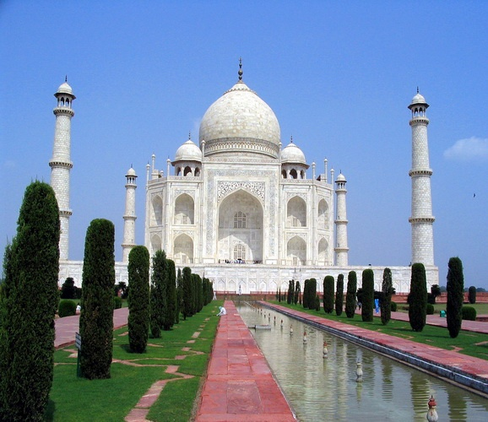

Slide 138
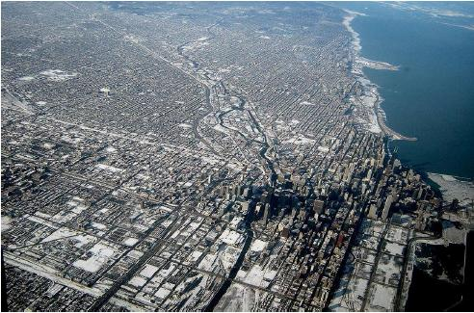

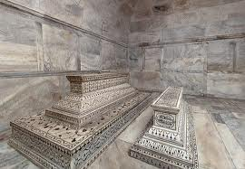


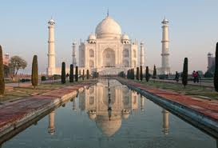
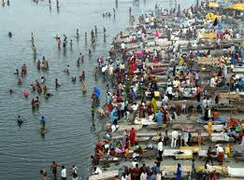
Level of Detailing in Scope

Slide 139
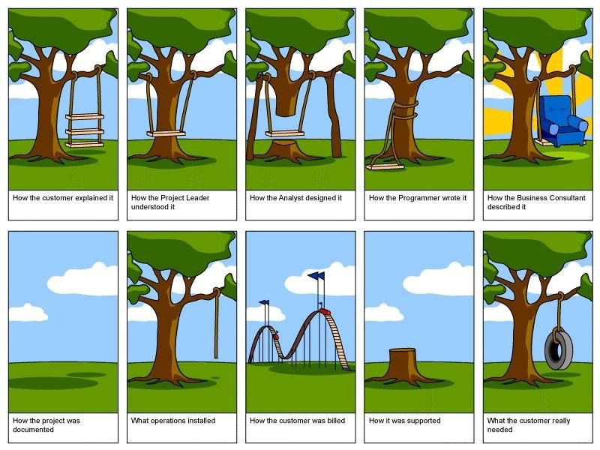
How the customer explained it
How the Project Leader understood it
How the Architect Designed it
How the Programmer wrote it
How the Business Consultant described it
How the project was documented
How operations installed it
What the customer really needed
How the customer was billed
How it was supported

Slide 140
Scope
Project Scope "The work that needs to be accomplished to deliver a product, service, or result with the specified features and functions."
Product Scope "The features and functions that characterize a product, service, or result."

Slide 141
Project Scope Management
Processes required to ensure that the project includes all the work required, and ONLY the work required to complete the project successfully

Slide 142
Project Scope Management
Plan Scope Management [PLANNING]
Collect Requirements [PLANNING]
Define Scope [PLANNING]
Create WBS [PLANNING]
Validate Scope [M&C]
Control Scope [M&C]

Slide 143
8. Plan Scope Management
Documenting how the project scope will be defined, validated and controlled

Slide 144
Plan Scope Management
PSM
PLAN
.1 Project charter
.2 Project management plan
• Quality management plan
• Project life cycle description
• Development approach
.3 EEFs
.4 OPAs
.1 Expert judgment
.2 Data analysis
• Alternatives analysis
.3 Meetings
.1 Scope management plan
.2 Requirements management plan

Slide 145
Plan Scope Management IO
Scope Management Plan includes
Process for preparing project scope statement (PSS)
Process that enable creation of WBS from PSS
Process that specifies how formal acceptance be obtained
Process to control changes to details PSS
Requirement Management Plan includes
Process of analyzing, documenting and managing requirements
Process of requirement prioritization
Product measurement metrics and their rationale
RTM structure
Configuration management activities related to product

Slide 146

9. Collect Requirements
The process of determining, documenting, and managing stakeholder needs and requirements to meet project objectives.

Slide 147
Collect Requirements
PSM
PLAN
.1 Project charter
.2 Project management plan
• Scope management plan
• Requirements management plan
• Stakeholder engagement plan
.3 Project documents
• Assumption log
• Lessons learned register
• Stakeholder register
.4 Business documents
• Business case
.5 Agreements
.6 EEFs
.7 OPAs
.1 Expert judgment
.2 Data gathering
• Brainstorming
• Interviews
• Focus groups
• Questionnaires and surveys
• Benchmarking
.3 Data analysis
• Document analysis
.4 Decision making
• Voting
• Multicriteria decision analysis
.5 Data representation
• Affinity diagrams
• Mind mapping
.6 Interpersonal and team skills
• Nominal group technique
• Observation/conversation
• Facilitation
.7 Context diagram
.8 Prototypes
.1 Requirements documentation
.2 Requirements traceability matrix

Slide 148
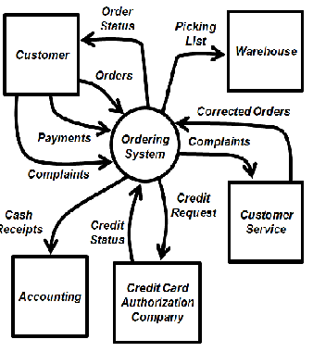
Context diagram

Slide 149
Requirement Traceability Matrix
Tracing Requirements to
Business needs, opportunities, goals & objectives
Project objectives
Project scope/WBS deliverables
Product design
product development
Test strategy and test scenarios
Traces high-level requirements to more detailed requirements.
Attributes in RTM can be
Unique identified
Textual description of requirement
Rationale for inclusion
Owner
Source
Priority
Version
Current Status (active, cancelled, differed, added, approved)
Date completed
Stability
Complexity
Acceptance Criteria

Slide 150
Requirement vs Scope
Scope and requirement are two different things.
Requirements are only those, which are in scope!
Requirements are driven from scope
Boundaries are defined first (using SOW), requirements are collected next
Requirement must be measurable, testable, traceable, complete, consistent and acceptable to key stakeholders.

Slide 151
Requirement Documentation includes
Business need or opportunity to be seized, describing the limitation of the current situation and why the project has been undertaken
Business and project objectives for traceability
Functional requirements, describing business process, information, and interaction with the product, as appropriate which can be documented textually in a requirements list, in models, or both
Non-functional requirements like SLA, performance, safety, security, compliance, supportability, retention/purge
Quality requirements
Acceptance criteria
Business rules stating the guiding principles
Impacts to other organizational areas call centre, technology centre, sales force
Impacts to other entities inside or outside the performing organization
Support and training requirements
Requirements assumptions and constraints

Slide 152
Discussion/Exercise-7
5 Minutes
How to collect, analyze, document, prioritize, manage req; how change should be initiated and impact analysis done; Tracking changes, configuration management activities, RTM structure
Write Requirement Management Plan for your projects OR
Write Columns of RTM for your project

Slide 153
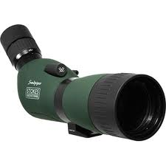
10. Define Scope
Developing a detailed description of the project and product.

Slide 154
Define Scope
PSM
PLAN
.1 Project charter
.2 Project management plan
• Scope management plan
.3 Project documents
• Assumption log
• Requirements documentation
• Risk register
.4 EEFs
.5 OPAs
.1 Expert judgment
.2 Data analysis
• Alternatives analysis
.3 Decision making
• Multicriteria decision analysis
.4 Interpersonal and team skills
• Facilitation
.5 Product analysis
.1 Project scope statement
.2 Project documents updates
• Assumption log
• Requirements documentation
• Requirements traceability matrix
• Stakeholder register

Slide 155
Define Scope
Product Analysis
Product breakdown
System analysis
Requirement analysis
System engineering: Deals with multiple complex systems
Value engineering: Functions, value, cost
Retain the function & value and reduce the cost
Value analysis: Debate the function and its cost
Discuss the value of function vs the cost
Alternative Identification
Alternative way of doing work

Slide 156
Scope Statement
Scope statement has following sections
Product Scope Description
Product Acceptance Criteria
Project Deliverables
Project Exclusions
Project Constraints (budget, imposed date, scheduled milestones, contractual provisions)
Project Assumptions
Organizational policies
Available skilled resources

Slide 157
Discussion/Exercise 8
5 Minutes
Product Scope Description, Product Acceptance Criteria, Project Deliverables
Project Exclusions, Project Constraints (budget, imposed date, scheduled milestones, contractual provisions), Project Assumptions, Organizational policies, Available skilled resources
Write Project Scope Statement for your project

Slide 158
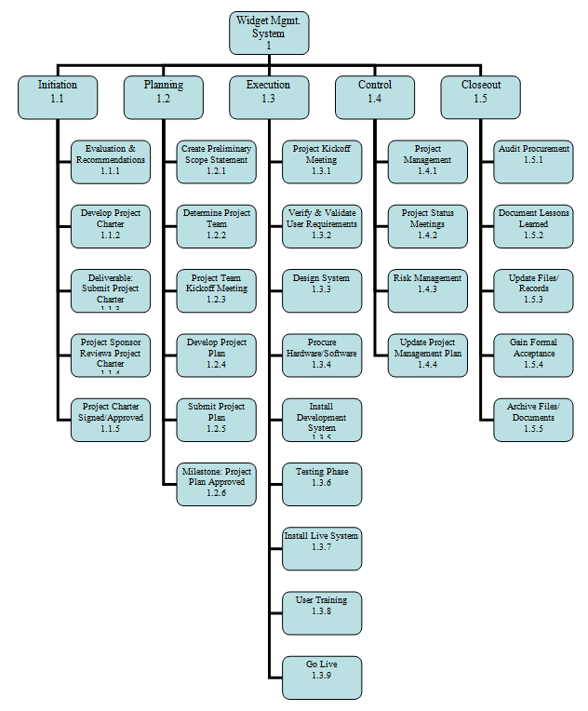
11. Create WBS
Subdividing project deliverables and project work into smaller, more manageable components.

Slide 159
Create WBS
PSM
PLAN
.1 Project management plan
• Scope management plan
.2 Project documents
• Project scope statement
• Requirements documentation
.3 EEFs
.4 OPAs
.1 Expert judgment
.2 Decomposition
1 Scope baseline
.2 Project documents updates
• Assumption log
• Requirements documentation

Slide 160
Scope baseline
Scope baseline is part of PMP, Scope baseline includes
Project Scope Statements
WBS
WBS Dictionary

Slide 161
WBS Types
Phase Driven
Department Driven
Milestone Driven
Component Driven
Location Driven
…….

Slide 162

Phase oriented WBS

Slide 163

Department oriented WBS

Slide 164

Subproject Oriented WBS

Slide 165
Discussion/Exercise 9
5 Minutes
Write 2 Level WBS & WBS Dictionary with min 5 deliverables for your project

Slide 166

12. Validate Scope
Formalizing acceptance of the completed project deliverables.

Slide 167
Validate Scope
PSM
M&C
.1 Project management plan
• Scope management plan
• Requirements management plan
• Scope baseline
.2 Project documents
• Lessons learned register
• Quality reports
• Requirements documentation
• Requirements traceability matrix
.3 Verified deliverables
.4 Work performance data
.1 Inspection
.2 Decision making
• Voting
.1 Accepted deliverables
.2 Work performance information
.3 Change requests
.4 Project document updates
• Lessons learned register
• Requirements documentation
• Requirements traceability matrix

Slide 168
Discussion/Exercise 10
5 Minutes
Write verify scope activities for your project; also write the name of deliverables verified.

Slide 169

13. Control Scope
Monitoring the status of the project and product scope and managing changes to the scope baseline.

Slide 170
Control Scope
PSM
M&C
.1 Project management plan
• Scope management plan
• Requirements management plan
• Change management plan
• Configuration management plan
• Scope baseline
• Performance measurement baseline
.2 Project documents
• Lessons learned register
• Requirements documentation
• Requirements traceability matrix
.3 Work performance data
.4 OPAs
.1 Data analysis
• Variance analysis
• Trend analysis
.1 Work performance information
.2 Change requests
.3 PMP updates
• Scope management plan
• Scope baseline
• Schedule baseline
• Cost baseline
• Performance measurement baseline
.4 Project documents updates
• Lessons learned register
• Requirements documentation
• Requirements traceability matrix

Slide 171
Discussion/Exercise-11
5 Minutes
Write work performance measurement metrics and their values for your project

Slide 173
Project Schedule Management

Slide 174

Project Time Management

Slide 175
Project Time Management
“Doing your project without a plan is like watching television with someone else holding the remote control”- Peter Turla
"The bad news is time flies. The good news is you're the pilot." - Michael Altshuler
"I made this letter longer than usual because I lack the time to make it shorter." – Pascal
“Time is a great teacher, but unfortunately it kills all its pupils." - Hector Louis Berlioz

Slide 176

Project Time Management
Processes required to manage timely completion of the project.

Slide 177
Project Time Management
Plan Schedule Management [PLANNING]
Define Activities [PLANNING]
Sequence Activities [PLANNING]
Estimate Activity Durations [PLANNING]
Develop Schedule [PLANNING]
Control Schedule [M&C]

Slide 178
14. Plan Schedule Management
Establishing the policies, procedures and documentation for planning, developing, managing, executing, and controlling the project schedule

Slide 179
Plan Schedule Management
PScM
PLAN
.1 Project charter
.2 Project management plan
• Scope management plan
• Development approach
.3 EEFs
.4 OPAs
.1 Expert judgment
.2 Data analysis
• Alternatives analysis
.3 Meetings
.1 Schedule management plan

Slide 180
Schedule Management Plan
It includes
Scheduling tools to be used
Level of accuracy
Units of measure for each resource
Organizational procedure links
Process of updating the progress in schedule model
Control thresholds
Rules of performance measurement (baselines, %complete, fixed formula etc.)
Define scheduling reporting format

Slide 181

15. Define Activities
Identifying the specific actions to be performed to produce the project deliverables

Slide 182
Define Activities
PScM
PLAN
.1 Project management plan
• Schedule management plan
• Scope baseline
.2 EEFs
.3 OPAs
.1 Expert judgment
.2 Decomposition
.3 Rolling wave planning
.4 Meetings
.1 Activity list
.2 Activity attributes
.3 Milestone list
.4 Change requests
.5 PMP updates
• Schedule baseline
• Cost baseline

Slide 183
Activity Attributes
Dependency
Location of performance
Type of dependency
Level of efforts (work contour)
Efforts required
Related Deadline
Related WBS account
Critical activity
Type of task (fixed duration, resources, work)
Resource & skills required
Duration
Lead & Lag

Slide 184
Discussion/Exercise 12
5 Minutes
Write activities & their attributes for previously created 2 level WBS for your project

Slide 185

16. Sequence Activities
Identifying and documenting relationships among the project activities.

Slide 186
Sequence Activities
PScM
PLAN
.1 PMP
• Schedule management plan
• Scope baseline
.2 Project documents
• Activity attributes
• Activity list
• Assumption log
• Milestone list
.3 EEFs
.4 OPAs
.1 Precedence diagramming method
.2 Dependency determination and integration
.3 Leads and lags
.4 PMIS
.1 Project schedule network diagrams
.2 Project documents updates
• Activity attributes
• Activity list
• Assumption log
• Milestone list

Slide 187
Discussion/Exercise 13
2 Minutes
Sequence Previously activities of your project write FS, SF, FF, SS after the activities
FS- (Finish first to start the next) Documentation & Review, Design & Development
FF- (Finish next to finish the previous) Product Documentation & Product System Testing
SF- (Start next to finish the previous) Shift working environment, changing motor, shifting applications from servers A to B, shifting work environment from A to B.
SS- (Start next to start previous) Listening & Speaking, Start meeting & Start a topic to discuss, Listening & Making Notes, Requirement Gathering & Requirement Analysis

Slide 188

Precedence Diagramming Method (PDM)
Also known as Activity on Nodes (AON)
Notes:
188

Slide 189
Activity Type
Fixed Work
Effort driven. Can change the duration by adding/ removing resources. E.g. To attempt 60 questions 60 min required. If you distributed between people duration can be altered.
Fixed Duration
Time driven. Can not change the duration by adding/removing resources. E.g. Duration of the training does not depend upon # of participants. It is fixed.
Fixed Units
Resource driven. Cannot change the duration by adding/removing resources. In fact altering number/type of resources make activity undoable. e.g Remove one person from review process where min 2 people are required.

Slide 190
Time Constraints
ASAP
ALAP
SNET
SNLT
FNLT
FNET
MFO
MSO

Slide 191
Network Development
Precedence Diagramming Method (AON)
A
B
C
Start
Finish
D
E
F

Slide 192
Network Development
Precedence Diagramming Method (AOA)
A
B
C
Start
Finish
F
D
E

Slide 193

17. Estimate Activity Durations
Approximating the number of work periods needed to complete individual activities with estimated resources.

Slide 194
Estimate Activity Durations
PScM
PLAN
.1 Project management plan
• Schedule management plan
• Scope baseline
.2 Project documents
• Activity attributes
• Activity list
• Assumption log
• Lessons learned register
• Milestone list
• Project team assignments
• Resource breakdown structure
• Resource calendars
• Resource requirements
• Risk register
.3 EEFs
.4 OPAs
.1 Expert judgment
.2 Analogous estimating
.3 Parametric estimating
.4 Three-point estimating
.5 Bottom-up estimating
.6 Data analysis
• Alternatives analysis
• Reserve analysis
.7 Decision making
.8 Meetings
.1 Duration estimates
.2 Basis of estimates
.3 Project documents updates
• Activity attributes
• Assumption log
• Lessons learned register

Slide 195
PERT – Program Evaluation and Review Technique
Beta Distribution
PERT Estimate tE= (Optimistic + 4 * Most Likely + Pessimistic)/6
Triangular Distribution
tE= (Optimistic + Most Likely + Pessimistic)/3
Standard Deviation (using PERT) = (Pessimistic-Optimistic)/6
Variance (using PERT) = ( (Pessimistic - Optimistic)/6)²

Slide 196
Discussion/Exercise 15
5 Minutes
Estimate Activity Duration for activities where resources are identified

Slide 197

18. Develop Schedule
Analyzing activity sequences, durations, resource requirements and schedule constraints to create the project schedule.

Slide 198
Develop Schedule
PScM
PLAN
.1 Project management plan
• Schedule management plan
• Scope baseline
.2 Project documents
• Activity attributes
• Activity list
• Assumption log
• Basis of estimates
• Duration estimates
• Lessons learned register
• Milestone list
• Project schedule network diagrams
• Project team assignments
• Resource calendars
• Resource requirements
• Risk register
.3 Agreements
.4 EEFs
.5 OPAs
.1 Schedule network analysis
.2 Critical path method
.3 Resource optimization
.4 Data analysis
• What-if scenario analysis
• Simulation
.5 Leads and lags
.6 Schedule compression
.7 PMISs
.8 Agile release planning
.1 Schedule baseline
.2 Project schedule
.3 Schedule data
.4 Project calendars
.5 Change requests
.6 PMP Updates
• Schedule management plan
• Cost baseline
.7 Project documents updates
• Activity attributes
• Assumption log
• Duration estimates
• Lessons learned register
• Resource requirements
• Risk register

Slide 199

Schedule Compression Techniques

Slide 200

Resource Optimization techniques
Resource Levelling
Ensure resource are not allocated more than their availability for the given project. Can lead to change in critical path.
Resource Smoothing
Adjust activities in such a way that resources requirement do not exceed than defined limit. No change in critical path. Activities can be delayed within their float (free/total).

Slide 201
Modeling Techniques
What if scenario analysis
Assess the feasibility of project schedule under adverse conditions. Prepare a contingency plan to overcome the problems. Or prepare mitigation plan to reduce the impact of unexpected situations.
Simulation
Calculate multiple project duration using tools like Monte Carlo Simulation. In this case use assumptions and distribution constructed using 3 Point estimates.

Slide 202

19. Control Schedule
Monitoring the status of the project to update project progress and manage changes to the schedule baseline

Slide 203
Control Schedule
PScM
M&C
.1 Project management plan
• Schedule management plan
• Schedule baseline
• Scope baseline
• Performance measurement baseline
.2 Project documents
• Lessons learned register
• Project calendars
• Project schedule
• Resource calendars
• Schedule data
.3 Work performance data
.4 OPAs
.1 Data analysis
• Earned value analysis
• Iteration burndown chart
• Performance reviews
• Trend analysis
• Variance analysis
• What-if scenario analysis
.2 Critical path method
.3 Project management
information system
.4 Resource optimization
.6 Leads and lags
.7 Schedule compression
.1 Work performance information
.2 Schedule forecasts
.3 Change requests
.4 Project management plan updates
• Schedule management plan
• Schedule baseline
• Cost baseline
• Performance measurement
baseline
.5 Project documents updates
• Assumption log
• Basis of estimates
• Lessons learned register
• Project schedule
• Resource calendars
• Risk register
• Schedule data

Slide 204

Product Vision, Release, Iteration Planning

Slide 205

Burndown Chart

Slide 206
Discussion/Exercise 17
5 Minutes
Write work performance measures and their values of your project with respect to Schedule Management

Slide 207
Big Concepts
Critical Path Method (CPM)
Critical Chain Method (CCM)

Slide 208
Critical Path Method (CPM)

Slide 209
Critical Path Method (CPM)
Critical Path method is a planning technique that is used to demonstrate and view the chronological activities of a program or project, and identifies any possible timing risks and can be used to establish the least amount of time to complete a project.

Slide 210
Critical Path
ES EF
ES EF
ES EF
ES EF
ES EF
ES EF
Duration 7 Task A
Duration 6 Task C
Duration 3 Task G
LS LF
LS LF
ES EF
LS LF
Duration 2 Task H
Start
Finish
ES EF
ES EF
ES EF
LS LF
Duration 3 Task B
Duration 3 Task D
Duration 3 Task E
LS LF
LS LF
LS LF
ES EF
Duration 2 Task F
LS LF

Slide 211
Critical Path – Longest Path, Zero Float
0
0
0
ES EF
ES EF
ES EF
Duration 7 Task A
0
7
Duration 3 Task G
Duration 6 Task C
13
16
7
13
0
7
7
13
13
16
0
LS LF
LS LF
ES EF
LS LF
Duration 2 Task H
16
18
Start
Finish
7
7
7
16
18
ES EF
ES EF
ES EF
LS LF
Duration 3 Task B
0
3
Duration 3 Task D
3
6
Duration 3 Task E
6
9
7
10
10
13
13
16
LS LF
LS LF
LS LF
8
ES EF
Duration 2 Task F
3
5
11
13
LS LF

Slide 212
Discussion/Excertise-16
5 Minutes
ES EF
ES EF
ES EF
Duration 4 Task A
Duration 4 Task B
Duration 3 Task C
LS LF
LS LF
LS LF
ES EF
ES EF
Duration 10 Task G
Start
Duration 7 Task D
Finish
LS LF
ES EF
LS LF
ES EF
Duration 5 Task E
Duration 5 Task F
LS LF
LS LF

Slide 213
Network Exercise - solution
Critical Path : ADCG
ES EF
ES EF
ES EF
Duration 4 Task A
0
4
Duration 3 Task C
Duration 4 Task B
11
14
4
8
0
4
7
11
11
14
LS LF
LS LF
LS LF
ES EF
ES EF
Duration 10 Task G
14
24
Duration 7 Task D
Start
4
11
Finish
14
24
4
11
LS LF
ES EF
LS LF
ES EF
Duration 5 Task E
0
5
Duration 5 Task F
5
10
4
9
9
14
LS LF
LS LF
Notes:
Free float: An activity can be delayed without impacting the start of next activity
Total float: As many alternative path that many total float. Total float is available on non critical path. Activities can be delayed without delaying project
Free float on critical path activities is Zero

Slide 214
Facts/Tips for Critical Path
Total Float is the amount of time the task can delayed without delaying the project finish date.
Free float is the amount of time a task can slip without delaying the early start of any task that immediately follows it
It is possible that a zero float activity may not be on critical path
Longest path & shortest time possible to complete the project
A project can multiple critical paths
Difference between late and early is float
Positive float (the activity can wait to start even after previous activity finishes)
Negative float (the activity must start before previous finishes)
Zero float (the activity must immediately start after the finish of previous one)
Crashing activities to short the overall duration of project
Fast-tracking activities to short the overall duration of project
Be cautious that non-critical activity is not being delayed than the allowed free float
Take care of sub-critical path or non-critical path
Manage critical path resources very closely
Do not overload critical path activity resources
Avoid multitasking for resources working on critical path activities

Slide 215
Benefits of PERT/CPM
It Provides following information
Expected Project completion time
Probability of completion before a specified date
The critical path activities that directly impact the completion time
The activities that have slack time and that can lend resources to critical path activities
Activity start and end dates

Slide 216
Critical Chain Method (CCM)

Slide 217
Background
Eliyahu Goldratt proposed CCM
This is developed based on the TOC framework

Slide 218
Why CCM is needed?
You have CPM available why CCM is needed?
You can manage the delays on non-critical path using buffers/floats. BUT
How do you manage the delays on critical path?

Slide 219
Principles Behind CCM
Delays accumulate; gains don't advantage
Sequential Steps: Resources are not available to start early
Parallel Steps: Three activity each takes 5 days time start in parallel. If one activity takes 10 days and other finish on time, early activities will not be able to take advantage.
If above sequential and parallel activities are dependent then affect is magnified
Other Time Wasters
Multitasking
Student Syndrome
Parkinson's Law

Slide 220
Critical Chain Method
CPM is developed using the believe that book as many resource as in advance and they will be available when need because it has been promised
CCM says that if a resource is over booked on any activity he will not be available to work on that activity therefore level the resource on the project activities. Thus resource constrained critical path is critical chain.
CPM is about hoarding, greed. Therefore over-estimation and project management laws like Parkinson law, Murphy law, Student syndrome applies here.
CCM is about believe and assumption that it will available when needed but we need to have proper alert system in place.

Slide 221
CCM Concepts
Resource Buffer: Notify dependent task resources that when I will finish my work on regularly basis and final notification 1-2 days before. So that resource is available to start the work.
Safety or project buffer should be added at the end of critical-chain as non-activity buffer
Feeding buffer: Add buffer where chain of non-critical activity joins the critical path. This way non critical task can be avoided being critical

Slide 222
How to estimate in CCM
Resource will give t80, t90 estimate.
Half them to get t50 estimate.
Do not put end date to task and let people finish the task as early as possible.
No penalty for finish beyond t50.
Project Buffer should be 50% of the buffer removed from activity.

Slide 223
How to manage CCM
If activity finishes late time is borrowed from project buffer.
If activity finishes early, gained time is added to project buffer

Slide 225
Project Cost Management

Slide 226


Project Cost Management

Slide 227
Project Cost Management- A Thought
If you don't plan, it doesn't work. If you do plan, it doesn't work either. Why plan!
The same work under the same conditions will be estimated differently by ten different estimators or by one estimator at ten different times. So why to estimate!
Any project can be estimated accurately (once it's completed).
Nothing is impossible for the person who doesn't have to do it.

Slide 228
Project Cost Management
Processes involved in estimating, budgeting, and controlling costs so that the project can be completed within the approved budget

Slide 229
Project Cost Management
Plan Cost Management [PLANNING]
Estimate Costs [PLANNING]
Determine Budget [PLANNING]
Control Costs [M&C]

Slide 230
Components of Contract Price
Contract Price = Material + Labor + Expenses + Overheads + Risk Management Budget + Profit Margins
Who estimates Material cost for your project?
Who estimates Labor cost for your project?
Who estimates Expenses cost for your project?
Who estimates Overhead cost for your project?
Where do you adjust the buffer?
Where do earn profit
What is the price?

Slide 231
Types of Cost
Fixed Cost vs Variable Cost
Direct vs Indirect Cost
Material, Labour, Services
Overhead Cost
Sunk Cost
Opportunity Cost

Slide 232
Types of Cost
Direct cost: purchased, used, consumed in the project directly.
Indirect cost: shared cost between project.

Slide 233
Types of Cost
Sunk Cost- Retrospective cost/ that cannot be recovered/ Cost gone and very low value or zero value was taken out. Plant developed but not of any use now additional money is required but by that money some better work can be done, so not to invest and let already invested money sunk. Software developed but it is not of any use now due any reason.
Perspective Cost- cost to be occurred in future
Allocated Cost- Cost of security service is shared by all division/companies of the building. Spreading the cost among those that use it.

Slide 234
Types of Cost
Apportioned Cost- To find apportioned cost you should know % of each appraised value (land, building, machine)
Value Added Cost- Sale price of a product and cost price of material is value add
Transfer Cost -Cost of transfer or transaction between two entities
Opportunity cost- Value lose because of exercising an option. It is just economic cost. Does not reflect in financial books

Slide 235
20. Plan Cost Management
Establishing policies, procedures and documentation for planning, managing, expending and controlling project costs

Slide 236
Plan Cost Management
PCM
PLAN
.1 Project charter
.2 Project management plan
• Schedule management plan
• Risk management plan
.3 EEFs
.4 OPAs
.1 Expert judgment
.2 Data analysis
• Alternatives analysis
.3 Meetings
.1 Cost management plan

Slide 237
Cost Management Plan
It includes
Cost management tools to be used
Level of accuracy (acceptable range +/- 5%)
Level of precision (US$ 100.01)
Units of measure for each resource
Organizational procedure links
Process of updating the progress in schedule model
Control thresholds (an allowed variation before some action need to be taken)
Rules of performance measurement (baselines, %complete, fixed formula etc.)
Project cost recording process
Currency exchange rate fluctuation adjustment process
Define scheduling reporting format

Slide 238

21. Estimate Costs
Developing an approximation of the costs of the resources needed to complete project activities.

Slide 239
Estimate Cost
PCM
PLAN
.1 Project management plan
• Cost management plan
• Quality management plan
• Scope baseline
.2 Project documents
• Lessons learned register
• Project schedule
• Resources requirements
• Risk register
.3 EEFs
.4 OPAs
.1 Expert judgment
.2 Analogous estimating
.3 Parametric estimating
.4 Bottom-up estimating
.5 Three-point estimating
.6 Data analysis
• Alternatives analysis
• Reserve analysis
• Cost of quality
.7 Project management
information system
.8 Decision making
• Voting
.1 Cost estimates
.2 Basis of estimates
.3 Project documents updates
• Assumption log
• Lessons learned register
• Risk register

Slide 240
Project Cost Estimation Ranges
Cost estimation may include only Direct Cost or in combination of with Indirect Costs
Class Name | % | Range
Definitive | - 5 -> +5% | 10%
Capital Cost | -15 -> +10% | 25%
Appropriation | -25 -> +15% | 40%
Budget Estimates | -10 -> +25% | 35%
Feasibility | -35 -> +25% | 60%
Order of Magnitude | -50 -> +50% | 100%

Slide 241
Exercise-18
3 Minutes
Write Activity cost estimates for 5 activities and their basis of estimates for your project

Slide 242
Three Point Estimates
Program Evaluation Review Technique (PERT)
ESTIMATED COST = (Pessimistic + 4*(Most Likely) + Optimistic) / 6

Slide 243
22. Determine Budget
Aggregating the estimated costs of individual activities or work packages to establish an authorized cost baseline

Slide 244
Determine Budget
PCM
PLAN
.1 Project management plan
• Cost management plan
• Resource management plan
• Scope baseline
.2 Project documents
• Basis of estimates
• Cost estimates
• Project schedule
• Risk register
.3 Business documents
• Business case
• Benefits management plan
.4 Agreements
.5 EEFs
.6 OPAs
.1 Expert judgment
.2 Cost aggregation
.3 Data analysis
• Reserve analysis
.4 Historical information review
.5 Funding limit reconciliation
.6 Financing
.1 Cost baseline
.2 Project funding requirements
.3 Project documents updates
• Cost estimates
• Project schedule
• Risk register

Slide 245


Project Budget Component

Slide 246

EAC, ETC, PV, AC, EV

Slide 247
Estimation Traps
Customer: “How long will this project take?”
Project Manager: “What is the project about?”
Customer: “It is a systems upgrade project.”
Project Manager: “Can you tell me more about the project?”
Customer: “I don’t know, we will get into that later, but just tell me how long will it take.”

Slide 248
Five Ways to Avoid Estimation Traps
Provide a range instead of number.
Ranges reveals level of uncertainty in the scope. Customer will appreciate it if you tell him why that kind of range is given.
+/- 10 or +/- 50%. You can discuss cone of uncertainty with customer
Highlight underlying assumptions and constraints
Based on this (current information) assign confidence level or probability
Use objective estimation techniques like 3 Point or PERT
Don't play estimation games like padding estimates by dubuling and then customer make it halve. Next time you quadruple it. This unnecessarily creates cycle of mistrust.
Use a combination of techniques and solicit multiple perspectives
Track and compare actual results
Initially everybody fights for getting “accurate estimates” after that people forget about it
Next time you are asked to provide an accurate estimate, don’t fall into the trap. Instead, use it as an opportunity to engage and educate your stakeholders about the reality of estimates.
Notes:
http://www.pmi.org/eNews/Post/2011_02-11/NLU_Get-Real-About-Your-Estimates.html

Slide 249
Exercise-19
3 Minutes
Establish cost performance baseline for your project & write funding requirements for your project.

Slide 250

23. Control Costs
Monitoring the status of the project to update the project budget and managing changes to the cost baseline

Slide 251
Control Cost
PCM
M&C
.1 Project management plan
• Cost management plan
• Cost baseline
• Performance measurement baseline
.2 Project documents
• Lessons learned register
.3 Project funding requirements
.4 Work performance data
.5 OPAs
.1 Expert judgment
.2 Data analysis
• Earned value analysis
• Variance analysis
• Trend analysis
• Reserve analysis
.3 To-complete performance index
.4 PMIS
.1 Work performance information
.2 Cost forecasts
.3 Change requests
.4 PMP updates
• Cost management plan
• Cost baseline
• Performance measurement baseline
.5 Project documents updates
• Assumption log
• Basis of estimates
• Cost estimates
• Lessons learned register
• Risk register

Slide 252
Big Concepts
Earn Value Management

Slide 253
Earned Value Management – Basic Concepts
Planned Value (PV)- BCWS
Authorized budget assigned to the work to be accomplishes for an activity or work
breakdown structure component.
Earned Value (EV)- BCWP
Value of work performed expressed in terms of the approved budget assigned to
that work for an activity or work breakdown structure component.
Actual Cost (AC)- ACWP
Total cost actually incurred and recorded in accomplishing work performed for an
activity or work breakdown structure component.

Slide 254
Earn Value Rules
0% - 100%
50% - 50%
20% - 80%
25% - 75%

Slide 255
Earned Value Management – S Curve
PV
AC
Cost
CV
SV
Progress Review
ΔT
EV
Time

Slide 256

How project is progressing?

Slide 257

How project is progressing?

Slide 258

How project is progressing?

Slide 259

How project is progressing?

Slide 260
EVM-Variances
CV (Cost Variance) = EV- AC
CV = 0 => the Project is proceeding as per plan on cost
CV < 0 => the Project is over budget
CV > 0 => the Project is under budget
SV (Schedule Variance) = EV- PV
SV = 0 => the project is on plan, time-wise
SV < 0 => the project is BEHIND schedule
SV > 0 => the project is AHEAD of schedule

Slide 261
EVM- Indexes
CPI (Cost Performance Index) tells you how much worth of job you are getting for every $ being spent.
CPI = EV/AC
CPI = 1 => the project is on plan, cost wise
CPI < 1 => the project is over budget or under performing
CPI > 1 => the project is under budget or over performing
SPI tells the PM how much worth of job has been completed against planned work
SPI = EV / PV
SPI = 1 => the project is on schedule
SPI < 1 => the project is BEHIND schedule
SPI > 1 => the project is AHEAD of schedule

Slide 262
EVM- Critical Ratio
CR tells the PM the overall shape of your project
CR= CPI x SPI
CR = 1 => the project is on schedule & within budget
CR < 1 => the project is BEHIND schedule or budget or both
CR > 1 => the project is AHEAD of schedule or budget or both

Slide 263

CPI & SPI Summary

Slide 264
Forecasting- ETC
Recalculate it, if original estimate are no longer valid now.
Calculate it manually based on the progress, if original estimates are still valid
ETC = BAC - EV

Slide 265
Forecasting- EAC
Estimate at Completion(EAC)
EAC (atypical) = AC + ETC (Re-estimated)
EAC (atypical) = AC + BAC – EV (Estimated based on Progress)
EAC (typical considering CPI & SPI) = AC + ETC/ (CPI x SPI)
EAC (typical)= AC + ETC / CPI = BAC/CPI
If you feel that you will be able to complete the project on time in spite of current delay then you can consider SPI as 1. In that case CR= SPI

Slide 266
Forecasting- Variance at Completion
Variance at Completion (VAC)
VAC = BAC – EAC
Variance at Completion (%)
PVAC= (BAC-EAC)/BAC

Slide 267
Forecasting: TCPI
TCPI (To complete Performance Index) can be calculated using BAC or EAC
TCPI using BAC = (BAC-EV) / (BAC-AC)
TCPI using EAC = (BAC-EV) / (EAC-AC)

Slide 268

Case Study — Case 1
PV = $ 500
EV = $ 500
AC = $ 500
This is the ideal situation where everything goes as per plan.

Slide 269
Case Study — Case 2
PV = $ 1,800
EV = $ 1,500
AC = $ 1,700
CV = EV – AC = - $ 200
SV = EV – PV = - $ 300
CPI = EV/AC = 0.88
SPI = EV/PV = 0.83
PV = $ 2,900
EV = $ 2,700
AC = $ 2,500
SV = -200
SPI = 0.92
CV = 200
CPI = 1.08
Calculate CV, SV, SPI, SPI

Slide 270
EVM- Case 3
PV = $ 1,700
BAC = $ 5000
EV = $ 1,800
AC = $ 1,600
CV = 200
SV = 100
CPI = 1.125
SPI = 1.058
EAC = BAC/ CPI = $4444
ETC =EAC-AC = 4444 – 1600 = $2844 (Org Estimate Incorrect)
ETC = BAC-EV = 5000 – 1800 = $3200 (Org Estimate Correct)
VAC = BAC – EAC= $556
TCPI using BAC = 5000-1800/5000-1600 = 0.941
TCPI using EAC = 5000-1800/4444-1600 = 1.125
Calculate CV, SV, CPI, SPI, EAC (Typical), ETC, VAC, TCPI

Slide 272
Project Quality Management

Slide 273

Project Quality Management

Slide 274
Quality Definitions from Quality Gurus
‘Quality is Predictability’- Deming
‘Conformance to requirements’ - Crosby
‘Fitness for use’ - Juran
‘Customer’s opinion’- Feigenbaum
‘The totality of characteristics of an entity that bear on its ability to satisfy stated and implied need’ - ISO 8402:1994
Conformance to “Valid Requirements“.
Customers' perception of the value of the suppliers‘ work output.
A perceived degree of excellence with a minimum, usually set forth by the customer.
Best value for money.

Slide 275
Quality Gurus
Philip B Corssby- Popularized concept of Zero Defect. He eliminate defects complete not only reduce it to acceptable quality level
Dr. Eliyahu M Goldratt- Theory of Constraints. Focus on single element on process chain which can address 99% problems.
Dr. Edward Deming- Deming Cycle (85% Quality Problems are related to Management)
Dr. Joseph M Juran- Developed Quality Triology (Q-Planning, Q-Improvement, Q-Control)
Dr. Walter Shewhart- PDCA (Theory of process control or Shewart Transformation Process)
Dr. Genichi Taguchi- Taguchi Methodology or Designing in Quality (Making a design which is less sensitive to variation rather than control the manufacturing variation)
Dr. Kaoru Ishikawa- Philosophy of Total Quality, Ishikawa Diagram
Shigeo Shingo- Developed lean concepts, refined JIT (lean manufacturing)
Taiichi Ohno- Developed concept of Seven Wastes; this is used to identify non-value-added activity
Armand V Feigenbaum: Developed Idea of Total Quality Control

Slide 276
Project Quality Management
Processes and activities of the performing organization that determine quality policies, objectives, and responsibilities so that the project will satisfy the needs for which it was undertaken

Slide 277
Project Quality Management
Plan Quality Management [PLANNING]
Manage Quality [EXECUTING]
Control Quality [M&C]

Slide 278
24. Plan Quality Management
Identifying quality requirements and/or standards for the project and product, and documenting how the project will demonstrate compliance.

Slide 279
Plan Quality Management
PQM
PLAN
.1 Project charter
.2 PMP
• Requirements management plan
• Risk management plan
• Stakeholder engagement plan
• Scope baseline
.3 Project documents
• Assumption log
• Requirements documentation
• Requirements traceability matrix
• Risk register
• Stakeholder register
.4 EEFs
.5 OPAs
.1 Expert judgment
.2 Data gathering
• Benchmarking
• Brainstorming
• Interviews
.3 Data analysis
• Cost-benefit analysis
• Cost of quality
.4 Decision making
• Multicriteria decision analysis
.5 Data representation
• Flowcharts
• Logical data model
• Matrix diagrams
• Mind mapping
.6 Test and inspection planning
.7 Meetings
.1 Quality management plan
.2 Quality metrics
.3 PMP updates
• Risk management plan
• Scope baseline
.4 Project documents updates
• Lessons learned register
• Requirements traceability matrix
• Risk register
• Stakeholder register

Slide 280
Cost of Quality
Cost of Conformance Cost of Nonconformance
Prevention Costs
(Build a quality product)
Training
Document processes
Equipment
Time to do it right
Appraisal Costs (Assess the quality)
Testing
Destructive testing loss
Inspections
Internal Failure Costs (Failures found by the project)
Rework
Scrap
External Failure Costs (Failures found by the customer)
Liabilities
Warranty work
Lost business
Money spent during the project to avoid failures
Money spent during and after the project because of failures
Source : PMI PMBOK® Guide Fifth Edition

Slide 281
Cost of Nonconformance- Iceberg
SCRAP
DOCUMENTED
REWORK
WARRANTY
WORK
FAILURE
ANALYSIS
LATE PENALTIES
CONFUSION
OVERTIME
RUSH
DELIVERIES
CUSTOMER
DISSATISFACTION
MISSED
OPPORTUNITIES
PRODUCT
IMAGE
REDESIGN
HIDDEN
REWORK
CORPORATE
IMAGE
LATE
DELIVERIES
DUPLICATION
OF EFFORT

Slide 282
Exercise-21
5 Minutes
Write sections of QMP of your project OR
Write Quality Metrics for your projects, their goal, and threshold values OR
Identify the name of checklists used in your project

Slide 283
25. Manage Quality
The process of translating the quality management plan into executable quality activities that incorporate the organization’s quality policies into the project.

Slide 284
Manage Quality
PQM
EXEC
.1 PMP
• Quality management plan
.2 Project documents
• Lessons learned register
• Quality control measurements
• Quality metrics
• Risk report
.3 OPAs
.1 Data gathering
• Checklists
.2 Data analysis
• Alternatives analysis
• Document analysis
• Process analysis
• Root cause analysis
.3 Decision making
• Multicriteria decision analysis
.4 Data representation
• Affinity diagrams
• Cause-and-effect diagrams
• Flowcharts
• Histograms
• Matrix diagrams
• Scatter diagrams
.5 Audits
.6 Design for X
.7 Problem solving
.8 Quality improvement methods
.1 Quality reports
.2 Test and evaluation
documents
.3 Change requests
.4 PMP updates
• Quality management plan
• Scope baseline
• Schedule baseline
• Cost baseline
.5 Project documents updates
• Issue log
• Lessons learned register
• Risk register

Slide 285
Design for x
The X in DfX can be different aspects of product development, such as reliability, deployment, assembly, manufacturing, cost, service, usability, safety, and quality. Using the DfX may result in cost reduction, quality improvement, better performance, and customer satisfaction.

Slide 286
Exercise-22
5 Minutes
Write the number of NCs were discovered in your project corresponding to the processes
Who is responsible to close NCs and report their status
List the corrective or preventive actions suggested by auditors

Slide 287
26. Control Quality
Monitoring and recording results of executing the quality activities to assess performance and recommend necessary changes.

Slide 288
Control Quality
PQM
M&C
.1 PMP
• Quality management plan
.2 Project documents
• Lessons learned register
• Quality metrics
• Test and evaluation documents
.3 Approved change requests
.4 Deliverables
.5 Work performance data
.6 EEFs
.7 OPAs
.1 Data gathering
• Checklists
• Check sheets
• Statistical sampling
• Questionnaires and surveys
.2 Data analysis
• Performance reviews
• Root cause analysis
.3 Inspection
.4 Testing/product evaluations
.5 Data representation
• Cause-and-effect diagrams
• Control charts
• Histogram
• Scatter diagrams
.6 Meetings
.1 Quality control measurements
.2 Verified deliverables
.3 Work performance
information
.4 Change requests
.5 PMP updates
• Quality management plan
.6 Project documents updates
• Issue log
• Lessons learned register
• Risk register
• Test and evaluation
documents

Slide 289

Data Analysis

Slide 290
Sigma Values
Sigma | Yield | Defects in Millions
+/-2 | 95.44% | 45600
+/-3 | 99.73% | 2700
+/-6 | 99.9999997% | 0.002
Sigma level (with 1.5 sigma shift) | DPMO | Percentage yield
1 | 691,462 | 30.8550%
2 | 308,538 | 69.1462%
3 | 66,807 | 93.3193%
4 | 6,210 | 99.3790%
5 | 233 | 99.9770%
6 | 3.4 | 99.99966%
7 | 0.019 | 99.999966%

Slide 291
Exercise-23
5 minutes
Write the Quality control activities on your project
List the values of various quality control measures on your project.
List the validated deliverables

Slide 293
Project Resource Management

Slide 294
Project Resource Management
Includes the processes to identify, acquire, and manage the resources needed for the successful completion of the project.

Slide 295
Project Resource Management
Plan Resource Management [PLANNING]
Estimate Activity Resources [PLANNING]
Acquire Resources [EXECUTING]
Develop Team [EXECUTING]
Manage Team [EXECUTING]
Control Resources [M&C]

Slide 296
27. Plan Resource Management
The process of defining how to estimate, acquire, manage, and utilize physical and team resources.

Slide 297
Plan Resource Management
PRM
PLAN
.1 Project charter
.2 Project management plan
• Quality management plan
• Scope baseline
.3 Project documents
• Project schedule
• Requirements documentation
• Risk register
• Stakeholder register
.4 EEFs
.5 OPAs
.1 Expert judgment
.2 Data representation
• Hierarchical charts
• Responsibility assignment matrix
• Text-oriented formats
.3 Organizational theory
.4 Meetings
.1 Resource management plan
.2 Team charter
.3 Project documents updates
• Assumption log
• Risk register

Slide 298
Human Resource Management Plan
Roles & Responsibilities (Role, Authority, Responsibility, Competency)
Project organization chart
Staffing management plan
Staff acquisition plan: From where and when the people will come, at what location they will come to work, what are the cost associated with each expertise, what kind of assistance is required from HR and functional manager of the resource
Resource calendar: When the recruitment should start, resource availability (resource histogram),
Staff release plan: When and how to release resources for smooth transition, so that resource cost is not counted in the project
Training need
Recognition & rewards
Complying with union contracts, government regulation or other HR policies

Slide 299


Slide 300
Responsibility Assignment Matrix - RAM
PERSON
Shiv Ram Jim Karl Rita Mohan …
PHASE
Requirements
S R A P P
Functional
S A P P
Design
S R A l P
Development
R S A P P
Testing
S P l A P
P = Participant A = Accountable R = Review required
I = input required S = Sign-off required

Slide 301
Resource Histogram
Staff hours
300
275
Senior Designers
250
225
200
175
Resource Usage
150
125
100
75
50
25
0
9
16
23
30
6
13
20
27
6
13
20
27
3
10
17
24
1
8
15
22
Jan
Feb
Mar
Apr
May
Weekly Resource Usage Staff Hours

Slide 302

28. Estimate Activity Resources
Estimating the type and quantities of material, people, equipment or supplies required to perform each activity.

Slide 303
Estimate Activity Resources
PRM
PLAN
.1 Project management plan
• Resource management plan
• Scope baseline
.2 Project documents
• Activity attributes
• Activity list
• Assumption log
• Cost estimates
• Resource calendars
• Risk register
.3 EEFs
.4 OPAs
.1 Expert judgment
.2 Bottom-up estimating
.3 Analogous estimating
.4 Parametric estimating
.5 Data analysis
• Alternatives analysis
.6 PMIS
.7 Meetings
.1 Resource requirements
.2 Basis of estimates
.3 Resource breakdown
structure
.4 Project documents updates
• Activity attributes
• Assumption log
• Lessons learned register

Slide 304
Resource Breakdown Structure
Project ABC RBS
Labor |  |  |  |  |  |  |  |  |  |  | Material | Expenses
PM (1) | Config Mgmt |  | Technical Leaderhsip |  |  | Dev Team |  |  | Test Team
 | Config Mgr | Release Mgr | Arch (1) | UIExpert (1) | DBA (1) | Sr.Dev (4) | Jr.Dev (3) | TL (1) | Test Mgr | Tester (4) | Laptop (10 Units) | Procurement Team
 |  |  |  |  |  |  |  |  |  |  | Desktop (Units) | Systems Team
 |  |  |  |  |  |  |  |  |  |  | Leaseline (2 Mpbs) | Travel Cost (3 People)
 |  |  |  |  |  |  |  |  |  |  | Servers (2 Units | Boarding Lodging Cost (60 Days)
 |  |  |  |  |  |  |  |  |  |  |  | HR

Slide 305
Discussion/Exercise 14
2 Minutes
Estimate Activity Resources for previously sequenced activities of your project

Slide 306
29. Acquire Resources
Confirming human resource availability and obtaining the team necessary to complete project assignments

Slide 307
Acquire Resources
PRM
EXEC
.1 PMP
• Resource management plan
• Procurement management plan
• Cost baseline
.2 Project documents
• Project schedule
• Resource calendars
• Resource requirements
• Stakeholder register
.3 EEFs
.4 OPAs
.1 Decision making
• Multicriteria decision analysis
.2 Interpersonal and team skills
• Negotiation
.3 Pre-assignment
.4 Virtual teams
.1 Physical resource assignments
.2 Project team assignments
.3 Resource calendars
.4 Change requests
.5 PMP updates
• Resource management plan
• Cost baseline
.6 Project documents updates
• Lessons learned register
• Project schedule
• Resource breakdown structure
• Resource requirements
• Risk register
• Stakeholder register
.7 EEFs updates
.8 OPAs updates

Slide 308
30. Develop Team
Process of improving competencies, team interaction, and the overall team environment to enhance project performance.

Slide 309
Develop Team
PRM
EXEC
.1 Project management plan
• Resource management plan
.2 Project documents
• Lessons learned register
• Project schedule
• Project team assignments
• Resource calendars
• Team charter
.3 EEFs
.4 OPAs
.1 Colocation
.2 Virtual teams
.3 Communication technology
.4 Interpersonal and team skills
• Conflict management
• Influencing
• Motivation
• Negotiation
• Team building
.5 Recognition and rewards
.6 Training
.7 Individual and team assessments
.8 Meetings
1. Team performance assessments
.2 Change requests
.3 PMP updates
• Resource management plan
.4 Project documents updates
• Lessons learned register
• Project schedule
• Project team assignments
• Resource calendars
• Team charter
.5 EEFs updates
.6 OPAs updates

Slide 310
Team Performance Assessment..
Skills acquired which increased productivity
Reduced turnover rate
Perform better within team
Increased cohesiveness- sharing info/ openness

Slide 311


Slide 312
31. Manage Team
Tracking team member performance, providing feedback, resolving issues and managing changes to optimize project performance.

Slide 313
Manage Team
PRM
EXEC
.1 Project management plan
• Resource management plan
.2 Project documents
• Issue log
• Lessons learned register
• Project team assignments
• Team charter
.3 Work performance reports
.4 Team performance assessments
.5 EEFs
.6 OPAs
.1 Interpersonal and team skills
• Conflict management
• Decision making
• Emotional intelligence
• Influencing
• Leadership
.2 PMIS
.1 Change requests
.2 PMP updates
• Resource management plan
• Schedule baseline
• Cost baseline
.3 Project documents updates
• Issue log
• Lessons learned register
• Project team assignments
.4 EEFs updates

Slide 314
Types of Power
Formal – positional, granted by organizational/upper mgmt
Expert – power earned through a recognized level of knowledge or skill in a specific area
Reward – the power to give a positive consequences, like promotions, salary rise etc.
Penalty – the power to provide negative consequences, like suspension, termination, reprimands
Referent – power gained when team members admire, and willingly follow an individual as a role model

Slide 315
Team Development / Tuckman Model
Five Stages of Team development
Forming – Members of the group get to know each other and try to set up some ground rules about behavior
Storming – Conflicts arise as various members of the group try to exert leadership and the methods of operation are being established
Norming – Conflicts are largely settled and a feeling of group identity emerges
Performing – Emphasis now is the task at hand
Adjourning – The group disbands
Sequence is followed for each individual/group

Slide 316
32. Control Resources
The process of ensuring that the physical resources assigned and allocated to the project are available as planned, as well as monitoring the planned versus actual use of resources, and performing corrective action as necessary

Slide 317
Control Resources
PRM
M&C
.1 Project management plan
• Resource management plan
.2 Project documents
• Issue log
• Lessons learned register
• Physical resource assignments
• Project schedule
• Resource breakdown structure
• Resource requirements
• Risk register
.3 Work performance data
.4 Agreements
.5 OPAs
.1 Data analysis
• Alternatives analysis
• Cost-benefit analysis
• Performance reviews
• Trend analysis
.2 Problem solving
.3 Interpersonal and team skills
• Negotiation
• Influencing
.4 PMIS
.1 Work performance information
.2 Change requests
.3 PMP updates
• Resource management plan
• Schedule baseline
• Cost baseline
.4 Project documents updates
• Assumption log
• Issue log
• Lessons learned register
• Physical resource assignments
• Resource breakdown structure
• Risk register

Slide 318
Big Concepts
Conflict Resolution
Motivational Theories
Leadership Styles
Management Theories

Slide 319
Conflict Management
Conflicts - good or bad ???
Traditional view – Conflicts are bad, created by people and to be avoided
Current view – Conflicts are good and need to be confronted in order to bring out real issues and resolve them
Hot Topics

Slide 320
Conflict Management
Sources of conflict
Schedules
Project Priorities
Technical Issues
Personality Conflict
Cost
Scarce resources
Personal work styles
Administrative Procedures

Slide 321
Conflict Management
Characteristics of conflict
Conflict is natural and forces a search for alternatives
Conflict is team issue
Openness resolves conflict
Conflict resolution should focus on issues, not personalities
Conflict resolution should focus on the present not on the past

Slide 322
Conflict Resolution
Withdrawal – avoiding, giving up, stop gap, passive reaction, buying time, appropriate for “cooling off” time, no solution. Lose-lose outcome
Smoothing – grudging agreement, avoids conflict, appeasing, friendly atmosphere. No lasting solution, lose outcome
Compromising – bargaining, acceptable agreement, some satisfaction to each party, not ideal solution, trade off, a form of definitive solution. Lose outcome.
Confronting/Problem Solving – approached as an issue to be solved by examining alternatives. Give and take attitude, open dialog – direct approach, pinpoints problem, develops alternatives, objectively resolves issues, time consuming, ultimate solution, Win-Win outcome
Collaborating – leading to consensus and commitment by incorporating multiple viewpoints and insights from differing perspectives.
Forcing – Uses power, used as a last resort, ill feeling may result, Win-lose outcome. Win-Lose outcome
Notes:
Withdraw: Many times collation parties gives warning and then withdraw the support. When one party feel that discussion will not bring any result and another party is strong
Smoothing: When both parties are trying to cover the actual issue to avoid the argument.
Compromising: When both parties leave something in order to achieve some peaceful solution

Slide 323
Conflict Resolution
HIGH
SMOOTHING
(ACCOMMODATING)
PROBLEM-SOLVING
(COLLABORATING)
RELATIONSHIP
ORIENTATION
COMPROMISE
WITHDRAWAL
(AVOIDING)
FORCING
(COMPETING)
LOW
LOW OBJECTIVE ORIENTATION HIGH

Slide 324

Motivational Theories

Slide 325
Motivational Theories
Frederick Herzberg's Hygiene & Motivation Factors
Abraham Maslow’s Hierarchy of Needs
Expectancy Theorem of Motivation by Victor Vroom
Job characteristics model of Oldham-Hackman
Theory X & Y of McGregor

Slide 326
Motivational Theories
Frederick Herzberg - Hygiene Factors and Motivating Agents (1954)
Hygiene factors
Supervision
Company policy and administrator
Positive working Condition
Interpersonal relations
Job Security
Status
Compensation
Personal life
Presence will not guarantee higher productivity Absence will result in poor productivity
Motivating factors
Achievements
Recognitions
Work Itself
Responsibility
Advancement
Possibility for growth
Motivation will not work without Hygiene

Slide 327
Motivational Theories
Abraham Maslow’s Hierarchy of Needs (1954)
(In order of priority)
Self Actualization
Self fulfillment, growth, learning
Accomplishment, Respect, Attention, Appreciation
Esteem
Love, affection, approval, friends, association
Social
Security, stability, freedom from threat and physical harm
Safety
Physiological
Air, water, food, house, clothing

Slide 328
Motivational Theories
Expectancy Theorem of Motivation by Victor Vroom
The extent to which an individual is motivated…
The level of expectation of their efforts will result in a desired outcome (effort performance linkage)
(Is the work important?)
The expectation that good work will be rewarded (Performance-reward linkage)
(Will I be rewarded?)
Attractiveness of the reward
(What is the value of the reward?)
Motivation will be high when all three factors are high

Slide 329
Motivational Theories
The Oldham-Hackman job characteristics model
Skill Variety – the number of job skills that the job holder has the opportunity to exercise
Task Identity – the degree to which your work and its result are identifiable as belonging to you
Task Significance – the degree to which your job has an influence on others
Autonomy – the discretion you have about the way that you do the job
Feedback – the information that you get back about the result of your work

Slide 330
Motivational Theories
McGregor’s Theory X
The average worker is inherently lazy and needs supervisions
The average worker dislikes work and avoids work whenever possible
To induce adequate effort, the supervisor must threaten punishment and exercise careful supervision
The average worker avoids increased responsibility and seeks to be directed
Theory X relies on Strict Rules, Performance incentives, Rewards, Threats to job security

Slide 331
Motivational Theories
McGregor’s Theory Y
Workers are willing to do the job without continuous supervision
The average worker wants to be active and finds the physical and mental effort on the job satisfying
Greatest results come from willing participation which will tend to produce self-direction towards goals without coercion and control
The average worker seeks opportunity for personal improvement and self respect
Theory Y relies on worker participation in decisions, cordial manager-worker relationships, worker designed job methodology, worker individualism

Slide 332






Leadership
Human Engineering
Business
Investment
Military
Nationalism

Slide 333
Personality
Personality refers to the individual differences in characteristic patterns of thinking, feeling, and behaving
Authentic (e.g., accepts others for what and who they are, show open concern);
Courteous (e.g., ability to apply appropriate behavior and etiquette);
Creative (e.g., ability to think abstractly, to see things differently, to innovate);
Cultural (e.g., measure of sensitivity to other cultures including values, norms, and beliefs);
Emotional (e.g., ability to perceive emotions and the information they present and to manage them; measure of interpersonal skills);
Intellectual (e.g., measure of human intelligence over multiple aptitudes);
Managerial (e.g., measure of management practice and potential);
Political (e.g., measure of political intelligence and making things happen);
Service-oriented (e.g., evidence of willingness to serve other people);
Social (e.g., ability to understand and manage people); and
Systemic (e.g., drive to understand and build systems

Slide 334
Leadership Style Depends..
The style a project manager selects may be a personal preference, or the result of the combination of multiple factors like
Leader characteristics (e.g., attitudes, moods, needs, values, ethics);
Team member characteristics (e.g., attitudes, moods, needs, values, ethics);
Organizational characteristics (e.g., its purpose, structure, and type of work performed); and
Environmental characteristics (e.g., social situation, economic state, and political elements).

Slide 335
Leadership Types
Laissez-faire (e.g., allowing the team to make their own decisions and establish their own goals, also referred to as taking a hands-off style);
Transactional (e.g., focus on goals, feedback, and accomplishment to determine rewards; management by exception);
Servant leader (e.g., demonstrates commitment to serve and put other people first; focuses on other people’s growth, learning, development, autonomy, and well-being; concentrates on relationships, community and collaboration; leadership is secondary and emerges after service);
Transformational (e.g., empowering followers through idealized attributes and behaviors, inspirational motivation, encouragement for innovation and creativity, and individual consideration);
Charismatic (e.g., able to inspire; is high-energy, enthusiastic, self-confident; holds strong convictions); and Interactional (e.g., a combination of transactional, transformational, and charismatic).

Slide 336
Leadership Theories
Theory Z Proposed by William Ouchi
According to Theory Z, people who don’t fit either Theory X or Theory Y are really a combination of the two.
People who develop a leadership style based on Theory Z, use different styles of leadership with different people, depending on the situation.

Slide 337
Leadership Theories
Contingency Theory of Fred Fiedler
No theory is best theory. Because best depends upon individual manager and organization.
Built on a combination of Theory Y behaviors and the Hygiene Theory
People are motivated to achieve level competency and will continue to be motivated by this need even after competency is reached

Slide 338
Key to Successful Team Management
Listens to subordinates to diagnose or solve problems
Sets goals and develops short- and long- range action plans
Gives directions about who is to do which tasks to what standards
Provides feedback on task performance
Rewards or disciplines task performance and personal characteristics
Develops subordinates

Slide 339
Key to Successful Team Management
Understanding that team is an Integral Unit of Organization
A team mission, objective, goals, strategy and role definition
A leader and an organizational support system
Managers responsive to needs of team members
Encourage participation and effective communication
Foster an atmosphere of trust among team members
Provide feedback effectively
A collective culture and style
Motivate team members with challenges & rewards

Slide 340
Halo effect
The halo effect is the assumption that because the person is good at a technology they’d also be good at managing a project. (Which may be wrong assumption).

Slide 341
Exercise-24
5 Minutes
Prepare Human Resource Management Plan Including
Staffing Management Plan for your project
Project Organization Structure
Ground Rules for working in project
Prepare Project Calendar
Prepare a training plan
Prepare a hiring plan
Appraisal and Feedback Plan
Discuss servant Leadership

Slide 343
Project Communication Management

Slide 344

Project Communications Management

Slide 345
Project Communication Management
Processes required to ensure timely and appropriate generation, collection, distribution, storage, retrieval and ultimate disposition of project information.

Slide 346
Project Communications Management
Plan Communications [PLANNING]
Manage Communication[EXECUTING]
Monitor Communications[M&C]

Slide 347
33. Plan Communications
Determining the project stakeholder information needs and defining a communication approach.

Slide 348
Plan Communication Management
PCOM
PLAN
.1 Project charter
.2 Project management plan
• Resource management plan
• Stakeholder engagement plan
.3 Project documents
• Requirements documentation
• Stakeholder register
.4 EEFs
.5 OPAs
.1 Expert judgment
.2 Communication requirements analysis
.3 Communication technology
.4 Communication models
.5 Communication methods
.6 Interpersonal and team skills
• Communication styles assessment
• Political awareness
• Cultural awareness
.7 Data representation
• Stakeholder engagement assessment matrix
.8 Meetings
.1 Communications management plan
.2 PMP updates
• Stakeholder engagement plan
.3 Project documents updates
• Project schedule
• Stakeholder register

Slide 349
Communication Requirements Analysis
Project resources should be expended only on communicating information that contributes to success or where a lack of communication can lead to failure.
Depends upon the responsibilities and relationship between performing organization and stakeholder.
Depends upon disciplines, departments, and specialties involved in the project.
Depends upon logistics of how many individuals will be involved with the project and at which locations.
Depends upon internal and External communication needs

Slide 350
Number of Communication Channels
N(N-1)/2
Two People, One Channel
Three People, Three Channel
Four People, Six Channel
Six People, Fifteen Channel

Slide 351
Communication Methods
Which communication technology should be used depends upon what communication method is the needed
Three Communication Methods
Interactive Communication
Phone, audio/video conferences, moderator lead discussion, workshop
Push Communication
Letters, memos, reports, emails, faxes, voice mail, press releases
Pull Communication
e-learning, knowledge repository, unknown people

Slide 352
Communication Model
Source
Encoding
Message
channel
Decoding
Receiver
Noise
Feedback

Slide 353
34. Manage Communication
As per the communication management plan creating, collecting, distributing, storing, retrieving and ultimate disposition of project information

Slide 354
Manage Communications
PCOM
EXEC
.1 Project management plan
• Resource management plan
• Communications management plan
• Stakeholder engagement plan
.2 Project documents
• Change log
• Issue log
• Lessons learned register
• Quality report
• Risk report
• Stakeholder register
.3 WPR
.4 EEFs
.5 OPAs
.1 Communication technology
.2 Communication methods
.3 Communication skills
• Communication competence
• Feedback
• Nonverbal
• Presentations
.4 PMIS
.5 Project reporting
.6 Interpersonal and team skills
• Active listening
• Conflict management
• Cultural awareness
• Meeting management
• Networking
• Political awareness
.7 Meetings
.1 Project communications
.2 PMP updates
• Communications management plan
• Stakeholder engagement plan
.3 Project documents updates
• Issue log
• Lessons learned register
• Project schedule
• Risk register
• Stakeholder register
.4 OPAs updates

Slide 355
Communication Methods
Individual Meetings
Group Meetings
Audio & Video conferences
Computer chats
Remote communication methods

Slide 356
Information distribution tools
Hardcopy distribution, manual filing systems, press released, shared access to electronic database
Electronic communication & conferencing tool: email, fax, voice mail, telephone, video, web conferencing, websites and web publishing
Electronic tools for project management web interfaces to scheduling and project management software, meeting and virtual office software, portals and collaborating work management tool

Slide 357
Distribute Information
Top Management /Client/Sponsor
Up
Horizontal
Horizontal
External Stakeholders/
Regulatory Agencies/
Press
Functional Manager/
Other Mgrs.
Project Manager
Down
Team Members/
Contributor/
Sub-Contractor

Slide 358
35. Monitor Communications
Ensuring the information needs of the project and its stakeholders are met.

Slide 359
Monitor Communications
PCOM
M&C
.1 Project management plan
• Resource management plan
• Communications management plan
• Stakeholder engagement plan
.2 Project documents
• Issue log
• Lessons learned register
• Project communications
.3 Work performance data
.4 EEFs
.5 OPAs
.1 Expert judgment
.2 PMIS
.3 Data analysis
• Stakeholder engagement assessment matrix
.4 Interpersonal and team skills
• Observation/ conversation
.5 Meetings
.1 Work performance
information
.2 Change requests
.3 PMP updates
• Communications management plan
• Stakeholder engagement plan
.4 Project documents updates
• Issue log
• Lessons learned register
• Stakeholder register

Slide 360
Communication Types
Informal | Meeting, Conversation | Email, Status Update, Memos
Formal | Speech, Presentation | Project Plan, Contract, Charter
 | Verbal | Written

Slide 361
Communication Management
Filtering – A phenomenon that occurs when a large portion of the message is lost in vertical/horizontal communication
Nonverbal communication carries 55% of the message
Progress Reports generally show problems after they have occurred.
A communication matrix is an excellent tool to identify the stakeholders and their requirements for communication.

Slide 362
Communication Management
Probable Factors
Sender’s reputation
Sender’s status within the organization
Environmental Background
Dysfunctional emotional behaviors
Situational Consideration – Predefined Mindset
Historical Consideration in message interpretation
Other Factors
Ambiguity in language
Culture
Semantics
Knowledge Base
Message Content – hidden agendas
Use of idiomatic language
Use of abbreviations

Slide 363
Cross Cultural Problems
Project may require inputs from individual and groups from different countries. Concerns related to communication are
Differences in culture
Differences in project environments.
Attitude – perceiving others using one’s own standards rather than other’s.
Stereotypes – sticking to a particular culture to apply in any situation
Thought patterns – differing culture across geographical distances/organizations
Time sense – differing sense of urgency

Slide 364
Exercise 25
30 Min
Prepare Communication Management Plan for your project
Information to be shared
Report formats (Name & Identifiers)
Reporting frequency
Reporting Technology
Purpose of Communication
Presenter
Audience (Name & Number)
Prepare different reporting formats
Progress Reports
Status Reports
Forecast Reports

Slide 366
Project Risk Management

Slide 367


Slide 368


Slide 369


Slide 370
Project Risk Management
Processes for conducting risk management planning, identification, analysis, response planning and monitoring and control on a project.

Slide 371
Project Risk Management
Plan Risk Management [PLANNING]
Identify Risks [PLANNING]
Perform Qualitative Risk Analysis [PLANNING]
Perform Quantitative Risk Analysis [PLANNING]
Plan Risk Responses [PLANNING]
Implement Risk Responses [EXECUTING]
Control Risks [M&C]

Slide 372
Personal Attitude to Risk
Individuals fall into one of the three categories
Risks Averse
Risk Seeking
Risk Neutral

Slide 373

Assumption, Constraint, Dependency & Risk

Slide 374
36. Plan Risk Management
Defining how to conduct risk management activities for a project .

Slide 375
Plan Risk Management
PRKM
PLAN
.1 Project charter
.2 Project management plan
• All components
.3 Project documents
• Stakeholder register
.4 EEFs
.5 OPAs
.1 Expert judgment
.2 Data analysis
• Stakeholder analysis
.3 Meetings
.1 Risk management plan

Slide 376

Risk Breakdown Structure
Source : PMI PMBOK® Fourth Edition

Slide 377

Definition of Impact
Source : PMI PMBOK® Fourth Edition

Slide 378
37. Identify Risks
Determining which risks may affect the project and documenting their characteristics

Slide 379
Identify Risks
PRKM
PLAN
.1 PMP
• Req MP, Sc-MP, CMP, QMP, Res-MP, Rk-MP
• Scope baseline
• Schedule baseline
• Cost baseline
.2 Project documents
• Assumption log, • Cost estimates
• Duration estimates, • Issue log
• Lessons learned register,
• Requirements documentation
• Resource requirements
• Stakeholder register
.3 Agreements
.4 Procurement documentation
.5 EEFs
.6 OPAs
.1 Expert judgment
.2 Data gathering
• Brainstorming
• Checklists
• Interviews
.3 Data analysis
• Root cause analysis
• Assumption and constraint analysis
• SWOT analysis
• Document analysis
.4 Interpersonal and team skills
• Facilitation
.5 Prompt lists
.6 Meetings
.1 Risk register
.2 Risk report
.3 Project documents updates
• Assumption log
• Issue log
• Lessons learned register

Slide 380
Diagramming Techniques
Cause and effect diagrams
System or process flow charts
Influence Diagram

Slide 381
38. Perform Qualitative Risk Analysis
Prioritizing risks for further analysis or action by assessing and combining their probability of occurrence and impact.

Slide 382
Perform Qualitative Risk Analysis
PRKM
PLAN
.1 Project management plan
• Risk management plan
.2 Project documents
• Assumption log
• Risk register
• Stakeholder register
.3 EEFs
.4 OPAs
.1 Expert judgment
.2 Data gathering
• Interviews
.3 Data analysis
• Risk data quality assessment
• Risk probability and impact assessment
• Assessment of other risk parameters
.4 Interpersonal and team skills
• Facilitation
.5 Risk categorization
.6 Data representation
• Probability and impact matrix
• Hierarchical charts
.7 Meetings
.1 Project documents updates
• Assumption log
• Issue log
• Risk register
• Risk report

Slide 383

Probability Impact Matrix
Define Threshold
High risk (“red condition”)
Medium risk (“yellow condition”)
Low risk (“green condition”)
Source : PMI PMBOK® Fourth Edition

Slide 384
39. Perform Quantitative Risk Analysis
Numerically analyzing the effect of identified risks on overall project objectives.

Slide 385
Perform Quantitative Risk Analysis
PRKM
PLAN
.1 PMP
• Risk management plan
• Scope baseline
• Schedule baseline
• Cost baseline
.2 Project documents
• Assumption log,• Basis of estimates, • Cost estimates, • Cost forecasts, • Duration estimates, • Milestone list, • Resource requirements, • Risk register, • Risk report, • Schedule forecasts
.3 EEFs
.4 OPAs
.1 Expert judgment
.2 Data gathering
• Interviews
.3 Interpersonal and team skills
• Facilitation
.4 Representations of
uncertainty
.5 Data analysis
• Simulations
• Sensitivity analysis
• Decision tree analysis
• Influence diagrams
.1 Project documents updates
• Risk report

Slide 386
PQnRA- Tools & Techniques
Data Gathering & Representation Techniques
Interview
Probability Distribution (Normal, Beta, Triangular)
Quantitative Risk Analysis Modeling Techniques
Sensitivity analysis- helps to determine which risks have the most potential impact- Tornado diagrams (compare relative importance and impact of variables of high degree of uncertainty)
Expected monetary value analysis (EMV)- Calculates average outcome of future scenarios that may or may not happen
Modeling & Simulation- Monte Carlo techniques

Slide 387
Formulae
Probability = Number of Occurrences / Total Number occurrences
= Frequency of Related Events / Total Number of Events
Probability = Frequency of Related Events /
Total Number of Possible Events
Expected Monetary Value (EMV) = Risk Event Probability X Risk Event Value
The sum of their probabilities of occurrence is 1.0

Slide 388

Decision Tree

Slide 389
Decision Tree
A Fixed Price Contract worth $150,000 has a clause of $1000 penalty per day of schedule delay. The following estimates for Cost and Schedule are provided:
Self-execute
Cost can vary : with a likelihood 80% ➔ 120,000 vs. with a likelihood of 20% ➔ 140,000
Schedule: can vary : 95% on time, 5% possibility of 2 days delay
Subcontract
Cost can vary : with a likelihood of 60% ➔ 110,000 vs. with a likelihood of 40% ➔ 120,000
Schedule can vary:: 80% on time, 20% possibility of 20 days delay

Slide 390
Decision Tree- Solution
Cost
Schedule
Probability
Profit Potential
.95
.76
150,000-120,000 = 30,000
22,800
Self -execute
.04
150,000-(120,000+2000) = 28,000
1,120
.05
.8
.95
.19
150,000-140,000 = 10,000
1,900
.2
.05
.01
150,000-(140,000+2000) = 8,000
80
25,900
.8
.48
150,000-110,000 = 40,000
19,200
.6
Subcontract
.2
.12
150,000-(110,000+20,000) = 20,000
2,400
.4
.8
9,600
.32
150,000-120,000 = 30,000
.2
150,000-(120,000+20,000) = 10,000
800
.08
32,000

Slide 391
40. Plan Risk Response
Developing options and actions to enhance opportunities and reduce threats to project objectives.

Slide 392
Plan Risk Response
PRKM
PLAN
.1 Project management plan
• Resource management plan
• Risk management plan
• Cost baseline
.2 Project documents
• Lessons learned register
• Project schedule
• Project team assignments
• Resource calendars
• Risk register
• Risk report
• Stakeholder register
.3 EEFs
.4 OPAs
.1 Expert judgment
.2 Data gathering
• Interviews
.3 Interpersonal and team skills
• Facilitation
.4 Strategies for threats
.5 Strategies for opportunities
.6 Contingent response strategies
.7 Strategies for overall project risk
.8 Data analysis
• Alternatives analysis
• Cost-benefit analysis
.9 Decision making
• Multicriteria decision analysis
.1 Change requests
.2 PMP updates
• ScMP, CMP, QMP, Res- MP, PrMP
• Scope baseline
• Schedule baseline
• Cost baseline
.3 Project documents updates
• Assumption log
• Cost forecasts
• Lessons learned register
• Project schedule
• Project team assignments
• Risk register
• Risk report

Slide 393
Risk Response Strategies
Negative Risk or
Threats
Escalate
Avoid (remove the cause of threat)
Mitigate (reduce the probability or impact)
Transfer (Shifting ownership)
Acceptance
Positive Risk or
Opportunities
Escalate
Exploit (ensure the opportunity is realized)
Enhance (enhance the probability or impact)
Share (Transferring ownership)
Acceptance

Slide 394
Negative Risk Responses
Avoid
Removing the cause of a threat, extending the schedule, changing the project strategy, or reducing scope. Some risks can be avoided by clarifying requirements, obtaining information, improving communication, or acquiring expertise.
Mitigate
Designing redundancy into a system may reduce the impact from a failure of the original component.
Transfer
Transfer ownership of a specific risk. Buy insurance, performance bonds, warranties, guarantees.
Accept
Acceptance can be either active or passive. The most common active acceptance strategy is to establish a contingency reserve. Passive acceptance involves no proactive action apart from periodic review.

Slide 395
Positive Risk Responses
Exploit
Examples: if you are getting some good quality resources at lower cost at certain location then offloading work to that location.
Enhance
Examples: if you are getting some good quality resources at lower cost at certain location then assigning offloading more and more work to that location.
Share
Examples: If you have some business opportunity which you cannot fulfill because of your know-how limitation then you can partner with company and you both can explore to work together to realize the benefits
Accept
Acceptance can be either active or passive. The most common active acceptance strategy is to establish a contingency reserve. Passive acceptance involves no proactive action apart from periodic review.

Slide 396
Understanding Reserves
Contingency reserves : Known – Unknown
It is designed for use only if certain events occur or only under certain predefined conditions, provided there is sufficient warning to implement the response.
Examples of events that may trigger the contingency response include missing intermediate milestones or gaining higher priority with a supplier.
Events triggering the contingency response should be triggered and tracked.
Management reserves: Unknown – Unknown
It is defined for use only if ‘the events that occur or only under certain conditions’, where information about the event & its occurrence is absolutely NOT available.

Slide 397
41. Implement Risk Responses
The process of implementing agreed-upon risk response plans.

Slide 398
Implement Risk Responses
PRKM
EXEC
.1 Project management plan
• Risk management plan
.2 Project documents
• Lessons learned register
• Risk register
• Risk report
.3 OPAs
.1 Expert judgment
.2 Interpersonal and team skills
• Influencing
.3 PMIS
.1 Change requests
.2 Project documents updates
• Issue log
• Lessons learned register
• Project team assignments
• Risk register
• Risk report

Slide 399
42. Monitor Risks
The process of monitoring the implementation of agreed-upon risk response plans, tracking identified risks, identifying and analyzing new risks, and evaluating risk process effectiveness throughout the project.

Slide 400
Control Risks
PRKM
M&C
.1 Project management plan
• Risk management plan
.2 Project documents
• Issue log
• Lessons learned register
• Risk register
• Risk report
.3 Work performance data
.4 Work performance reports
.1 Data analysis
• Technical performance analysis
• Reserve analysis
.2 Audits
.3 Meetings
.1 Work performance information
.2 Change requests
.3 PMP updates
• Any component
.4 Project documents updates
• Assumption log
• Issue log
• Lessons learned register
• Risk register
• Risk report
.5 OPAs updates

Slide 401
Risk Management Terms
Contingency Reserve
A separately planned quantity used to allow for future situations which may be planned for only in part (sometimes called “Known-unknowns”)
Intended to reduce the impact of missing cost or schedule objectives
Normally included in the project costs
Management Reserves
“A separately planned quantity used to allow for future situations which are impossible to predict (sometimes called “Unknown- unknowns”)
Intended to reduce the risk of missing cost or schedule objectives
Use of Management reserves requires a change to the project’s cost baseline
Residual Risks
Residual risks are those that remain after response measures have been taken.
Include minor risks that have been accepted and addressed. E.g., By adding contingency amounts to the cost or by allowing time
Secondary risks
Risks that arise as a result of implementing risk response
Should be identified and responses planned

Slide 402
Exercise 26
30 Min
Prepare Risk Management Plan for your project
Setup a template to capture all the information to manage risk
Training content for risk awareness
Training audience
Roles & Responsibilities for Risk Management Activities
Risk assessment techniques & tools
Risk Manager, Risk Audits Frequency, Risk Auditor
Define Impact Table
Define Probability and Impact Table/ Risk Tolerances of Stakeholders
Prepare Risk Register
Analyse Assumptions, Constraints, Dependencies of your project
Identify Risk for your projects
Prepare Risk Response Plan
Prepare Risk Response Strategy for every risk which cannot be tolerated
Establish Contingency Fund
Discuss Unknown-Unknown and Management Reserve

Slide 404
Project Procurement Management

Slide 405





Slide 406
Project Procurement Management
Processes necessary to purchase or acquire products, services or results needed from outside the project team.

Slide 407
Another look @ Procurement Management
INTEGRATION
SCOPE
STAKEHOLDER
TIME
Life Cycle
Environment Variations
Project
Definitions
Expectations
Time
Objectives
RESOURCES
PROCUREMENT
MANAGEMENT
COST
Availability
Productivity
Cost
Objectives
Directives
Data Exchange
Specification
Assurance
Risk Contracting
Performance, Service, Materials
COMMUNICATION
QUALITY
RISK

Slide 408
Project Procurement Management
Plan Procurement Management [PLANNING]
Conduct Procurements [EXECUTING]
Control Procurements [M&C]

Slide 409
Project Manager’s Role
Identifying project procurement needs
Determine contract types and potential providers
Identify/select procurement source
Assessing quality and completeness of contract
Verify product/service acceptance
Structured review of the procurement process

Slide 410
43. Plan Procurement Management
Documenting project purchasing decisions, specifying the approach and identifying potential sellers.

Slide 411
Plan Procurement
PPM
PLAN
.1 Project charter
.2 Business documents
• Business case
• Benefits management plan
.3 PMP
• SMP, • QMP, • Res-MP
• Scope baseline
.4 Project documents
• Milestone list
• Project team assignments
• Req. Doc, • RTM, • RR, • SR
• Resource requirements
.5 EEFs
.6 OPAs
.1 Expert judgment
.2 Data gathering
• Market research
.3 Data analysis
• Make-or-buy analysis
.4 Source selection analysis
.5 Meetings
.1 Procurement management
plan
.2 Procurement strategy
.3 Bid documents
.4 Procurement statement of
work
.5 Source selection criteria
.6 Make-or-buy decisions
.7 Independent cost estimates
.8 Change requests
.9 Project documents updates
• Lessons learned register
• Milestone list, • RR, • SR
• Requirements documentation
• Requirements traceability matrix
.10 OPAs

Slide 412
Procurement Strategy
To determine the project delivery method, the type of legally binding agreement(s), and how the procurement will advance through the procurement phases.
Delivery methods
Service: Subcontracting allowed / not-allowed/ JV
Construction: design build (DB), design bid build (DBB), design build operate (DBO), build own operate transfer (BOOT)
Contract payment types
Procurement phases

Slide 413
Procurement Management Plan
Describes how the procurement processes will be managed
Types of Contracts to be used
Managing Multiple Providers
Coordination with other project aspects

Slide 414
Source selection criteria
Understanding of need
Overall or life-cycle cost
Technical capability
Risk
Management Approach
Technical Approach
Warranty
Financial Capacity
Production Capacity and interest
Business size and type
Past performance of sellers
References
Intellectual property rights
Proprietary rights

Slide 415
44. Conduct Procurements
Process involves obtaining seller responses, selecting a seller and awarding a contract.

Slide 416
Conduct Procurement
PPM
EXEC
.1 Project management plan
• SMP, • Req-MP, • CoMP,
• RMP, • PrMP, • ConMP
• Cost baseline
.2 Project documents
• Lessons learned register
• Project schedule
• Requirements documentation
• Risk register
• Stakeholder register
.3 Procurement documentation
.4 Seller proposals
.5 EEFs
.6 OPAs
.1 Expert judgment
.2 Advertising
.3 Bidder conferences
.4 Data analysis
• Proposal evaluation
.5 Interpersonal and team skills
• Negotiation
.1 Selected sellers
.2 Agreements
.3 Change requests
.4 PMP Updates
• Req-MP, • QMP, • CoMP, • RMP,
• PrMP
• Scope baseline
• Schedule baseline
• Cost baseline
.5 Project documents updates
• Lessons learned register
• Requirements documentation
• RTM, • RR, • SR
• Resource calendars
.6 OPAs

Slide 417
TOC of Agreement
Procurement statement of work or major deliverables;
Schedule, milestones, or date by which a schedule is required;
Performance reporting;
Pricing and payment terms;
Inspection, quality, and acceptance criteria;
Warranty and future product support;
Incentives and penalties;
Insurance and performance bonds;
Subordinate subcontractor approvals;
General terms and conditions;
Change request handling; and
Termination clause and alternative dispute resolution mechanisms.

Slide 418
45. Control Procurement
Managing procurement relationships, monitoring contract performance and making changes and corrections as needed.

Slide 419
Control Procurement
PPM
M&C
.1 Project management plan
• ReqMP, • RMP, • PrMP
• Change management plan
• Schedule baseline
.2 Project documents
• Assumption log
• Lessons learned register
• Milestone list
• Quality reports
• Requirements documentation
• RTM, RR, SR
.3 Agreements
.4 Procurement documentation
.5 Approved change requests
.6 Work performance data
.7 EEFs
.8 OPAs
.1 Expert judgment
.2 Claims administration
.3 Data analysis
• Performance reviews
• Earned value analysis
• Trend analysis
.4 Inspection
.5 Audits
.1 Closed procurements
.2 Work performance information
.3 Procurement documentation updates
.4 Change requests
.5 PMP updates
• Risk management plan
• Procurement management plan
• Schedule baseline
• Cost baseline
.6 Project documents updates
• Lessons learned register
• Resource requirements
• RTM, RR, SR
.7 OPAs updates

Slide 420
Claim Administration
Contested changes or potential constructive changes are those requested changes where buyer and seller cannot reach to an agreement for payment.
Settle through negotiation
Follow the ADR (alternative dispute resolution) method established in contract.

Slide 421
Procurement: Tips for PMP® Exam
Questions are written from buyer’s perspective
Seller is not supplying people to adjunct the buyer’s team (seller remains external to the project team)
Contracts require formality
All product and project management requirements should be specifically stated in the contract
If it is not in a contract, it can be done if a change is issued
If it is in the contract, it must be done or a change order, signed by both parties issued
Changes must be in writing

Slide 422
Procurement: Tips for PMP® Exam
Contracts are legally binding
Contracts should help diminish project risk
Most governments back all contracts by providing a court system for dispute resolution
Questions are written by government contracting specialists of USA
In many parts of the world (including India), contracts are informal and relationships between parties is more important than the contract
It is important to take a more formal approach to the procurement process when answering questions

Slide 423
Big Concepts
Contract Structure
Contract Types
Legal Requirement on Contracts
Contract Change Control

Slide 424
Contract Structure

Slide 425
Sections of Contract
SOW or Deliverables
Schedule Baseline
Performance Reporting
Period of Performance
Roles & Responsibilities
Seller's Place of Performance
Pricing
Payment Terms
Place of delivery
Inspection and acceptance criteria

Slide 426
Sections of Contract
Warranty
Product Support
Limitation of liability
Fees and retainage
Penalties
Incentives
Insurance and performance bonds
Subordinate subcontractors approvals
Change request handling
Termination and alternative dispute resolution Mechanism

Slide 427
Contract Types

Slide 428
Procurement Contract Types
Different types of contracts are more or less appropriate for different types of purchases.
Time and material contracts
Unit Price contracts
Fixed Price or lump sum contracts
Cost reimbursable contracts

Slide 429
Contract type & Risk
100%
Buyer
Risk
Seller
0%
CPPC
CPFF
T&M
CPAF
CPIF
FPEPA
FPIF
FP

Slide 430
Types of Contracts
T & M – Time & Materials
The seller is paid for the amount of time it takes to accomplish the work & also reimbursed for the materials to complete the work
Unit Price – Fixed Price
The seller is paid a fixed price for an agreed upon Unit of Supply
Continued …

Slide 431
Types of Contracts- Fix Price Plus
FFP – Firm Fixed Price
Lump sum/firm Fixed Price. Seller at most risk
FPIF – Fixed Price Incentive Fee
Most difficult to administer. It contains a number of cost/profit schemes like, cost, target profit, target price, ceiling price and share ratio. if seller maximizes profits, an incentive is offered to reduce costs and improve efficiency price, seller effort. but no profit
FP-EPA— Fixed Price with Economic Price Adjustment
The seller is paid a fixed price. The contract is reviewed at pre-defined intervals in the project for adjustments to the contract price based on certain parameters

Slide 432
Types of Contracts- Cost Plus
CPFF— Cost Plus Fixed Fee Not desirable from buyer’s point of view. The contractor is reimbursed its cost + a fixed fee
CPAF-Cost Plus Award Fee
Not desirable from buyer's point of view. The contractor is influenced to increase costs.
CPIF— Cost Plus Incentive Fee
Seller is reimbursed for an agreed upon performance cost along with a pre established fee plus an incentive bonus. The buyer and seller share the uncertainty to a certain degree

Slide 433
Contract Examples
&
Exercises

Slide 434
Contract type Example: Fixed Price
Fixed Price (FP)
Contract = $1,100,000
It is fixed regardless of any other information
Fixed Price Economic Price Adjustment (FPEPA)
Contract = $1,100,000 but a price increase will be allowed in year two based on the U.S. Consumer Price Increase report for year one; or
Contract = $1,100,000 but a price increase will be allowed in year two to account for increases in specific material costs

Slide 435
Fixed Price Incentive Fee (FPIF)
Simple Case
Contract = $1,100,000. For every month early the project is completed, an additional $10,000 is paid to the seller. For every month late the project is completed a penalty of $20,000 is levied on the seller
If project is completed 2 months early, Contract = $1,120,000
If project is completed 2 months late, Contract = $1,060,000
Complex Case
PTA is a point on cost line upto where buyer pays the money for the service which buyer is buying. If Cost is more then PTA Profit starts dipping because customer is not paying any cost. So profits starts dipping and after some profit washes away and seller start making loss.
PTA = [Ceiling Price - Target Price]/ Buyer's Ratio + Target Cost
Note: Target Price = Target Cost + Target Profit

Slide 436

Point of Total Assumption

Slide 437
CPIF- Complex Case
Input Data for Question
Target Cost = $ 300,000 (Finish the work in this budget)
Target Profit = $ 50,000 (if seller do then he gets $50,000 for his good work)
Target Price = Target Cost + Target Profit
Ceiling Price = $ 370,000 (Seller will not spend more than in any condition else he has to bare the every extra from his pocket)
Share/Buyer-Seller Ratio = 70/30 (Share the profit or over expense in this ratio until they are below ceiling price)
If actual cost of the project is $335,000 then how much is the profit?
Calculations
PTA= ((Ceiling Price – Target Price)/buyer’s Share Ratio) + Target Cost
PTA = (370,000 - 350,000) / .7 + 300,000 => 328,571
Cost over run above PTA = PTA – Target Cost = 28,571
Between Target Cost and PTA spending (cost) will be split between the parties like this
Buyer's share (70% of 28,571) = 20,000 , Seller's share (30% of 28,571) = 8,571
Seller has to pay for extra spending over PTA ie. Actual Cost- PTA = 335,000 – 328,571 = 6,429
Profit will dip by Seller’s Share of Loss + Over Spending above PTA = 8,571 + 6,429 = 15000
Final Profit = 50,000 – 15,000 = $35,000

Slide 438
Contract type Example: Cost Reimbursable
Cost-Plus-Percentage of Cost (CPPC)
Contract = Cost plus 12% of costs as fee
If seller cost = 1,000,000
Then, Contract = $1,120,000
Cost-Plus-Fixed-Fee (CPFF)
Contract = Cost plus a fee of $100,000
If seller cost = 1,000,000
Then, Contract = $1,100,000

Slide 439
Contract type Example: Cost Reimbursable
Cost-Plus-Incentive-Fee (CPIF)
If ceiling price is not defined then
Final payout = Target cost + Fixed fee + Buyer share ratio * (Actual Cost - Target Cost)
If ceiling price is defined then
Final payout = Target cost + Fixed fee + Buyer share ratio * (Ceiling Price - Target Cost)
Fixed fee (Target Profit) $100,000. Target cost of $1,000,000, the buyer to seller benefit/cost share ratio is 60/40. Minimum fee is $75,000, Maximum fee is $150,000.
If project is completed at a cost of $900,000, Final Payout= $1,040,000.
If project is completed at a cost of $1,100,000, Final Payout = $1,175,000.
Note: “Target Profit” and “Fixed Fee” are interchangeable words

Slide 440
CPIF Example
Final payout = Target cost + Fixed fee + Buyer share ratio * (Actual Cost - Target Cost)
Final payout = Target cost + Fixed fee + Buyer share ratio * (Ceiling Price - Target Cost)
Minimum Fee: nnn, Maxmum Fee: mmm
Min Fee | NA | NA | 50 | NA
Max Fee | NA | NA | 90 | NA
Ceiling Price | NA | 1100 | NA | NA
Target Cost | 1000 | 1000 | 1000 | 1000
Fixed Feed (Target Profit) | 100 | 100 | 100 | 100
Buyer/Seller Benefit/cost sharing | 80% /20% | 80% /20% | 80% /20% | 60% / 40%
Actual Cost | 900 | 900 |  | 900
Contract Value | 1020 | 1020 |  | 1040
Profit | 120 | 120 |  | 140
Actual Cost | 1200 | 1200 | 1200 | 1100
Contract Value | 1260 | 1100 | 1190 | 1160
Profit/Loss | 60 | -160 | -70 | 60

Slide 441
Contract type Example: Time & Material
Contract = Material $1000/CuM of concrete, Labour $200/CuM of concrete
If actual quantity 100 CuM then Contract = $120,000
If actual quantity 75 CuM then Contract = $90,000

Slide 442
Legal Requirements on Contracts
Performing the promises in the contract between seller and buyer
Essential elements of a contract
Offer – clearly stated in a manner that can be understood by a reasonable person
Contract must be between competent persons (mental state, age)
Contract must have lawful objectives

Slide 443
Legal Requirements on Contracts
Acceptance by the buyer, based on genuine assent of both parties
Consideration – Most important part of the contract. It means something of value is received by the seller in exchange for meeting the promise
Follows all laws where the contract execution occurs

Slide 444
Procurement Management: Few More Concepts
Acronyms
IFB- Invitation for Bid,
RFB- Request for Bid,
LOI- Letter of Intent,
RFQ- Request for Quotation
RFP- Request for Proposal
NTT – Notice to tender
ITB – Instructions to Bidders
IFB or RFB/P :
Single Price,
High $ Value
RFQ used :
Per Item/Hour Price,
Lower $ Value,
May be used to develop info in RFP.
Tender will have
NTT
ITB
Technical Specs
Techno Commercial Formats
Price Bid

Slide 445
Procurement Management: Few More Concepts
T& M Used when you must begin work immediately without a procurement statement of work
If seller need to do more work in cost plus fixed fee contract then he should negotiate to change in contract. Otherwise seller will not get more than fixed fee, no matter how much he works.
An IFB is typically a request for a sealed document that lists the seller’s firm price to complete the detailed work.
A letter of intent is not binding in a court of law, it does make the seller feel more comfortable about expending funds before a contract is signed.

Slide 446
Contract Change Control System (CCCS)
CCCS is a process for modifying the contract.
Contract change control system (CCCS) is part of integrated change control system
PM should focus on Buyer Seller relationship
Following are part of CCCS
Paperwork
Tracking Systems
Dispute resolution processes
Approval Levels necessary for authorizing changes

Slide 448
Project Stakeholder Management

Slide 449
Project Stakeholder Management
Identify Stakeholders [INITIATING]
Plan Stakeholder Engagement [PLANNING]
Manage Stakeholder Engagement [EXECUTING]
Monitor Stakeholder Engagements [M&C]

Slide 450
46. Identify Stakeholders
Identifying all people, group or organizations that could be impacted by the project and documenting relevant information regarding their interests, involvement and impact on project success.

Slide 451
Identify Stakeholders
PSTM
INIT
.1 Project charter
.2 Business documents
• Business case
• Benefits management plan
.3 PMP
• CoMP, StEP
.4 Project documents
• Change log
• Issue log
• Req. documentation
.5 Agreements
.6 EEFs
.7 OPAs
.1 Expert judgment
.2 Data gathering
• Questionnaires and surveys
• Brainstorming
.3 Data analysis
• Stakeholder analysis
• Document analysis
.4 Data representation
• Stakeholder mapping/ representation
.5 Meetings
.1 Stakeholder register
.2 Change requests
.3 PMP updates
• ReqMP, CoMP, RMP, StEP
.4 Project documents updates
• Assumption log
• Issue log
• Risk register

Slide 452
Sample Stakeholder Analysis Matrix
 | Stakeholders
 | Ahmed | Susan | Erik | Mark | David
Organization | Internal Senior Management | Project team | Project Team | Hardware Vendor | Project manager for other internal project
Role on project | Sponsor of project and one of the compnay's founder | DBA sequencing expert | Lead Programmer | Supplies some istrument hardware | Competing for company resources
Unique Facts | Demanding, likes details, business focus, stanford MBA | Very smart, Ph.D. in biology, easy to work with, has a toddler | Best Programmer I know, weird sense of humor | Start-up company, he knows we can make him rich if this works | Nice guy, one of oldest people at company, has 3 kids in college
Level of interest | Very high | Very high | High | Very high | Low to medium
Level of Influence | Very high, can call the shots | SME, critical to success | High; hard to replace | Low; other vendors available | Low to medium
Suggestions on managing relationship | Keep informed, let him lead conversations, do as he says and quickly | Make sure she reviews specifications and leads testing; can do some work from home | Keep him happy so he stays; emphasize stock options; likes mexican food | Give him enough leads time to deliver hardware | He knows his project takes a back seat to this one, but can learn from him

Slide 453
Sample Stakeholder Analysis Matrix
Stakeholder | Stakeholder Interest(s) in the Project | Assessment of Impact | Potential Strategies for Gaining Support or Reducing Obstacles

Slide 454

Power/Interest Grid with stakeholders
Regulatory Authorities
Sponsor, Team
Individual Citizens
Vendor

Slide 455

Level of Stakeholder Engagements
Source: https://www.stakeholdermap.com/stakeholder-engagement.html

Slide 456
Engagement Approaches
Advisory committees
Blog
Conferences/large meetings
Displays and exhibits
Door knocks
Email
Facebook
Focus groups
Formal memos
Forums
Games
Google +
Google groups
Hoardings (construction site perimeter fences)
Infographics
Information hotline
Interviews - 1 to 1s
Leaflets
Letters (addressed)
Linkedin Companies
Linkedin Groups
Listening post/surgeries
Magazines
Media / news items
Meetings
Memos
Newsletters
One-off Circulars/leaflets/newsletter
Online collaboration
Online video
Open house/open day Petitions
Phone calls
Podcast
Polls
Project meetings/briefings
Public meetings
Section/article in existing circular/leaflet/newsletter
Skype calls or similar
Social media
Socialising/corporate hospitality
Surgeries for individuals with specific questions
Surveys
Teleconferencing
Twitter
Video conferencing
Videos
Walking tour/site tour
Webinars
Website
Workshops and focus groups
You tube or Vimeo
Source: https://www.stakeholdermap.com/stakeholder-engagement.html

Slide 457
Stakeholder Engagement Matrix
Stakeholder | Unaware | Resistant | Neutral | Supportive | Leading
Stakeholder A | C |  |  | D
Stakeholder B |  | C | D
Stakeholder C |  |  |  | C | D
Stakeholder D |  |  | C D

Slide 458
47. Plan Stakeholder Engagement
Developing appropriate management strategies to effectively engage stakeholders throughout the project lifecycle

Slide 459
Plan Stakeholders Engagement
PSTM
PLAN
.1 Project charter
.2 PMP
• ResMP, • CoMP, • RMP
.3 Project documents
• Assumption log
• Change log
• Issue log
• Project schedule
• RR, • SR
.4 Agreements
.5 EEFs
.6 OPAs
.1 Expert judgment
.2 Data gathering
• Benchmarking
.3 Data analysis
• Assumption and constraint analysis
• Root cause analysis
.4 Decision making
• Prioritization/ranking
.5 Data representation
• Mind mapping
• Stakeholder engagement assessment matrix
.6 Meetings
.1 Stakeholder engagement plan

Slide 460

48. Manage Stakeholder Engagements
Process of communicating and working with stakeholders to meet their needs and addressing issues as they occur.

Slide 461
Manage Stakeholders Engagements
PSTM
EXEC
.1 PMP
• CoMP, RMP, StEP
• Change management plan
.2 Project documents
• Change log
• Issue log
• Lessons learned register
• Stakeholder register
.3 EEFs
.4 OPAs
.1 Expert judgment
.2 Communication skills
• Feedback
.3 Interpersonal and team skills
• Conflict management
• Cultural awareness
• Negotiation
• Observation/ conversation
• Political awareness
.4 Ground rules
.5 Meetings
.1 Change requests
.2 PMP updates
• Communications management plan
• Stakeholder engagement plan
.3 Project documents updates
• Change log
• Issue log
• Lessons learned register
• Stakeholder register

Slide 462
49. Monitor Stakeholder Engagements
Monitoring overall project stakeholder relationships and adjusting strategies and plans to engage stakeholders.

Slide 463
Monitor Stakeholder Engagements
PSTM
M&C
.1 PMP
• ResMP, • CoMP, • StEP
.2 Project documents
• Issue log
• Lessons learned register
• Project communications
• Risk register
• Stakeholder register
.3 Work performance data
.4 EEFs
.5 OPAs
.1 Data analysis
• Alternatives analysis, • Root cause analysis, • Stakeholder analysis
.2 Decision making
• Multicriteria decision
Analysis, • Voting
.3 Data representation
• Stakeholder engagement assessment matrix
.4 Communication skills
• Feedback, • Presentations
.5 Interpersonal and team skills
• Active listening, • Cultural awareness, • Leadership
• Networking, • Political awareness
.6 Meetings
.1 Work performance information
.2 Change requests
.3 PMP updates
• ResMP, • CoMP,
• Stakeholer EP
.4 Project documents updates
• Issue log
• Lessons learned register
• RR, • SR

Slide 465

Professional
Responsibility
As
Integrated part of
Complete project
life cycle
Notes:
PMP Preparation Processes
www.Compulinkgroup.com
465

Slide 466

Every Projects Exists in an Environment

Slide 467





Slide 468
Honesty
Honesty is our duty to understand the truth and act in a Truthful manner both in our communication and in our conduct
We earnestly seek to understand the truth
We are truthful in our communications and conduct and provide in timely manner
We make commitments and promises in good faith ( implied & explicit)
We do not engage on or condone behavior that is designated to deceive others
We do not engage in dishonest behavior with the intention of personal gain or at the expense of other.

Slide 469
Responsibility
Responsibility is our duty to take ownership for the decisions we make or fail to make, the actions we take or fail to take & the consequences that result
Make decisions and take actions based on the BEST interests of society, Public safety and the environment
We accept those assignments that are consistent with our background, experience, skills and qualifications
We inform ourselves and uphold the policies, rules and regulations and laws that governs our work, professional and volunteer activities
We report unethical or illegal conduct to appropriate management & if necessary to those affected by the conduct
We bring violations of this Code to the attention of the appropriate body for resolution. We only file ethics complaints when they are substantiated by facts.
Notes:
PMP Preparation Processes
www.Compulinkgroup.com
469

Slide 470
Respect
Respect is our duty to show a high regard for ourselves, others and the resources entrusted to us
We inform ourselves about norms and customs of others and avoid engaging in behaviors they might consider disrespectful
We listen to others points of view , seeking to understand them
We approach directly those persons with whom we have conflict
We conduct ourselves in a professional manner
We negotiate in good faith, do not exercise the power of our expertise or position to influence decisions

Slide 471
Fairness
Fairness is our duty to make decisions and act impartially & Objectively. Our conduct must be free from competing self interest , Prejudice and favoritism.
We demonstrate transparency in decision making and constantly re-examine our impartiality .
We provide equal access to information to those authorized & equal opportunities to qualified candidates
We do not discriminate against others based on, but not limited to , Gender, Race, Age, Religion, Disability, Nationality or Sexual orientation.

Slide 472
Fairness
Conflict of Interest:
We proactively and fully disclose any real or potential conflicts of interest to the appropriate stakeholders.
When we realize that we have a real or potential conflict of interest :
We refrain from engaging in the decision making process or otherwise
attempting to influence outcomes, unless or until we have made full disclosure to the affected stakeholders.
We do not hire or fire, reward or punish, or award or deny contracts based on personal considerations. Including but not limited to Favoritism, Nepotism, or Bribery.

Slide 473
Ethics Quick Test
Texas Instruments “Ethics Quick Test” for making ethical decisions
Is the action legal?
Does it comply with your understanding of company values?
If you do it, will you feel bad?
How will it look in the newspaper?
If you know it is wrong, do not do it.
If you are not sure, ask.
Keep asking until you get an answer.
Notes:
What are some examples of projects?

Slide 474
Project Manager’s Oath of Professional Responsibility

Slide 475
Professional Responsibility
Ensure individual integrity
Adhere to legal requirements and ethical standards
Protect Stakeholders
Share lessons learned and other relevant information
Build capabilities of colleagues
Advance project management professionalism
Improve competencies as project manager
Balance stakeholder interests in project
Respect cultural ethnic and personal differences
Ensure collaborative project management environment
Comply with all organizational rules and policies
Notes:
What are some examples of projects?

Slide 476
Professional Responsibility
Provide accurate and truthful representations in cost estimates
Provide accurate and truthful representations in project reports
Report violations of policies, procedures and code of ethics
Strive for fair resolutions
Satisfy competing needs and objectives
Interact with others in a professional manner
Be responsible for satisfying the complete scope and objectives of customer requirements
Maintain and respect confidential information
Notes:
What are some examples of projects?

Slide 477
Professional Responsibility
Ensure that a conflict of interest does not interfere with professional judgment
Disclose conflict of interest to customer
Disclose circumstances that could be construed as conflicts of interest
Refrain from offering or accepting inappropriate payments, gifts, or other forms of compensation
Adhere to all applicable laws or customs of the country where services are being provided
Respect intellectual property developed or owned by others
Act in a accurate, truthful and competent manner
Notes:
What are some examples of projects?

Slide 478
Free Mock PMP® Exam Questions
No. | Question Banks | URL | Question No.
1 | Oliver Lehmann (Online) | http://www.oliverlehmann.com/pmp-self-test/75-free-questions.htm | 75Q
2 | HeadFirst PMP® Mock Exam | http://www.headfirstlabs.com/PMP/free_exam/ | 200Q
3 | Free PM Exam Simulator (Free 7-day Trial) | http://nanacast.com/vp/10002461/490529/20501/ | 170Q
4 | Simplilearn Free PMP® Mock Exam | https://www.simplilearn.com/pmp-exam-prep-free-practice-test | 200Q
5 | Oliver Lehmann (Downloadable PDF) | http://www.oliverlehmann.com/contents/free-downloads/175_PMP_Sample_Questions.pdf | 175Q
6 | Edwel Mock Exam | http://edwel.com/Free-Resources/PMP-Certification-Practice-Exam.aspx | 75Q

Slide 480

Hari P Thapliyal,
MCA, MBA (Operations), PGDFM, ZED Master Trainer, PMP, MCITP,
PMI-ACP, PRINCE2 Practitioner, SCT, CSM, MCT, SDC, SCM, SPOC, SAMC
PMO Architect & Project Management Evangelist
Profile: http://in.linkedin.com/in/harithapliyal
For content related queries please contact me via
hari.Prasad@vedavit-ps.com
This document is proprietary and confidential. It remains the property of Vedavit Project Solutions at all times. No part of this document may be used, reproduced, or transmitted in any form or by any means electronic, including photocopying and recording, for any purpose without express consent of Vedavit Project Solutions.

